Slide 1







MARSOP3-LOT II (Remote Sensing)
Interim Meeting of Phase 3.2 (April 2012→October 2012)
5-6 November 2012, JRC-Ispra
Herman Eerens, Dominique Haesen, Bart Ooms,
Else Swinnen, Carolien Toté & Lieven Bydekerke
MANAGEMENT
TASKS MSG-SEVIRI Eur+Afr (T2)
SPOT-VGT Global (T8)
SPOT-VGTp Europe (T4)
NOAA-AVHRR Europe (T3)
METOP-AVHRR Global+Eur (T5)
TERRA-MODIS Eur+IGAD (T6/7)
C. SOFTWARE
D. CONCLUSIONS & PLANNING

Slide 2
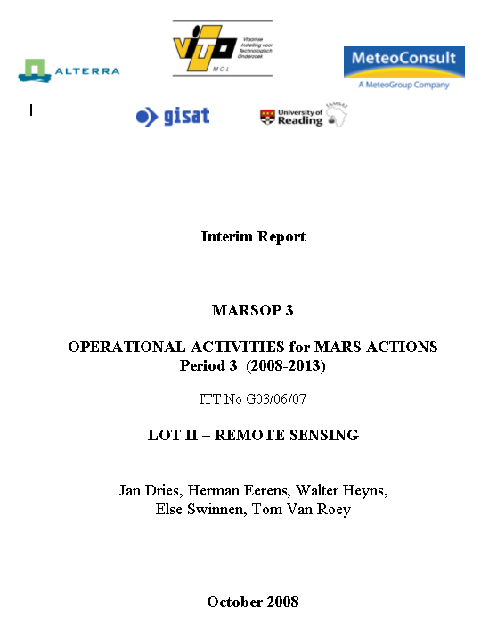
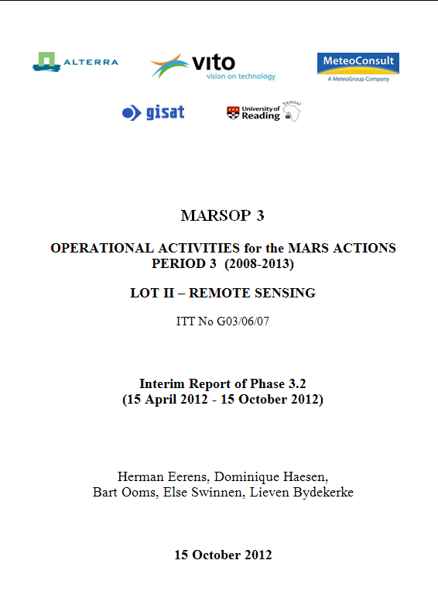
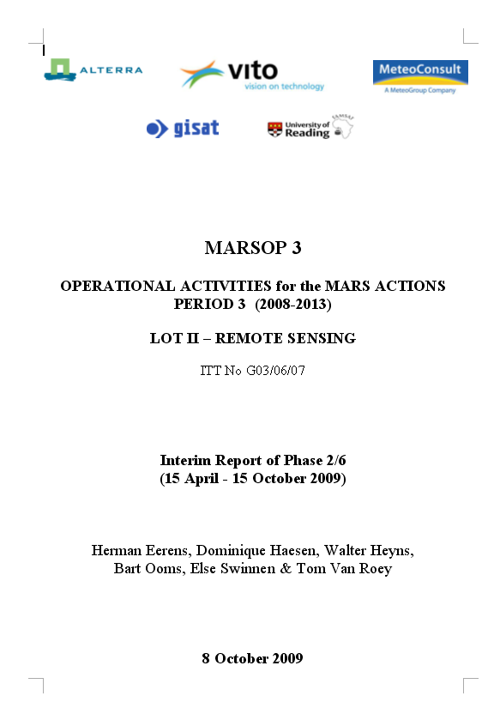
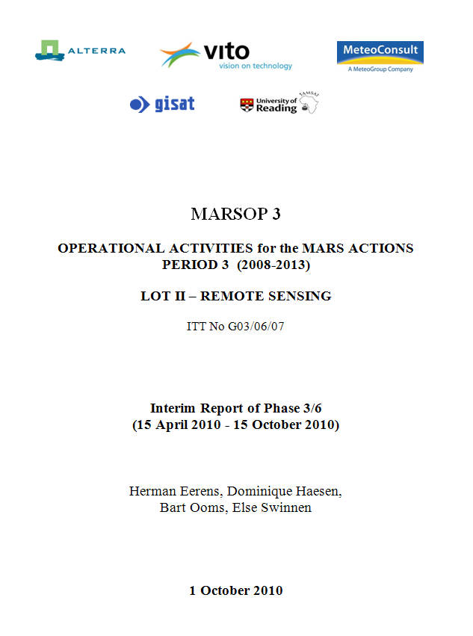
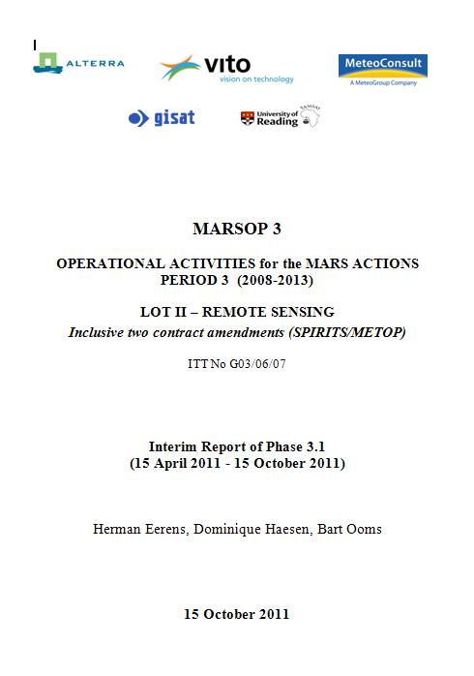

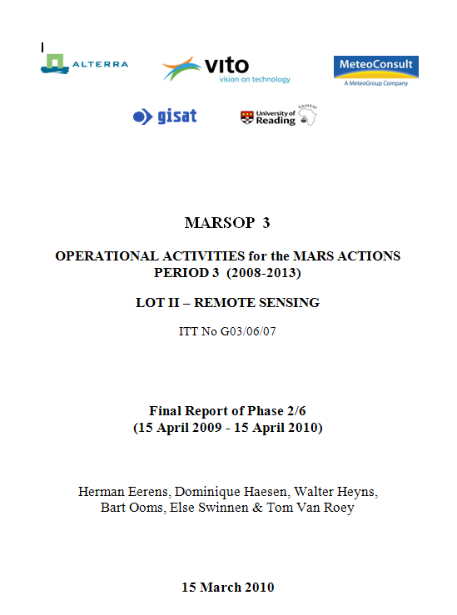
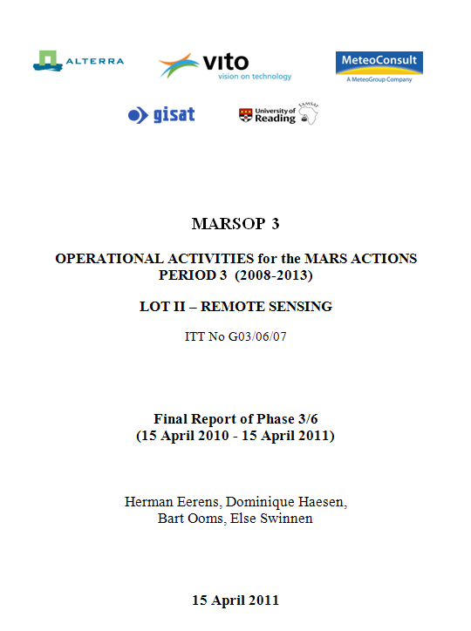
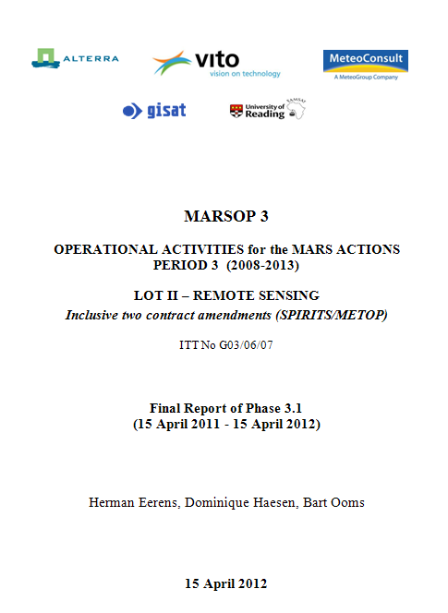
MANAGEMENT: Reports of MARSOP3 – Lot II
Remarks:
- Final > Interim reports
- JRC asked for more
concise reports

Slide 3
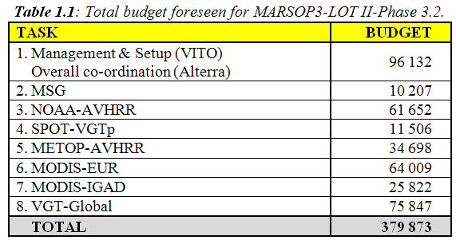
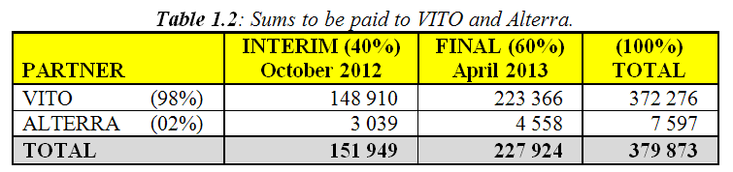
MANAGEMENT: Budgets for MARSOP3 - Lot II

Slide 4
MANAGEMENT: Three Contract Extensions
WIKI (€ 7 500)
Deadline passed since long
But now we finally started (Else Swinnen)
Significant contribution from JRC-Agri4cast
Should be completely finished in 2012
METOP-AVHRR Global (€ 30 000)
Fully realized & operational since January 2012
I.e. long before the deadline of April 2012
SPIRITS: Software & Documentation (€ 30 000)
Deadline (April 2012) not reached
Rather September 2012
Complex matter: software, manual, tutorial, IPR, …
See further (+ dedicated meeting tomorrow 7/11)

Slide 5




PRE-PROCESSING ⇔ POST-PROCESSING
SATELLITE
JRC, Alterra, …
INGEST (FTP, Eumetcast)
DISSEMINATE
RAW DATA (segments)
INFORMATION (IMG, QLK, RUM)
Corrections→ Composit
LINUX/C++/AppWorx
Calibration
Geo-correction
Atmo-correction
Cloud/snow detection
S10-compositing
Walter Heyns
Bart Ooms
All further operations …
Windows/GLIMPSE/BAT
Dominique Haesen
Herman Eerens
S10-COMPOSITES (CONTINENTAL→GLOBAL)

Slide 6
MARSOP3-LOT II (Remote Sensing)
Interim Meeting of Phase 3.2 (April 2012→October 2012)
5-6 November 2012, JRC-Ispra
Herman Eerens, Dominique Haesen, Bart Ooms,
Else Swinnen, Carolien Toté & Lieven Bydekerke
MANAGEMENT
TASKS MSG-SEVIRI Eur+Afr (T2)
SPOT-VGT Global (T8)
SPOT-VGTp Europe (T4)
NOAA-AVHRR Europe (T3)
METOP-AVHRR Global+Eur (T5)
TERRA-MODIS Eur+IGAD (T6/7)
C. SOFTWARE
D. CONCLUSIONS & PLANNING

Slide 7
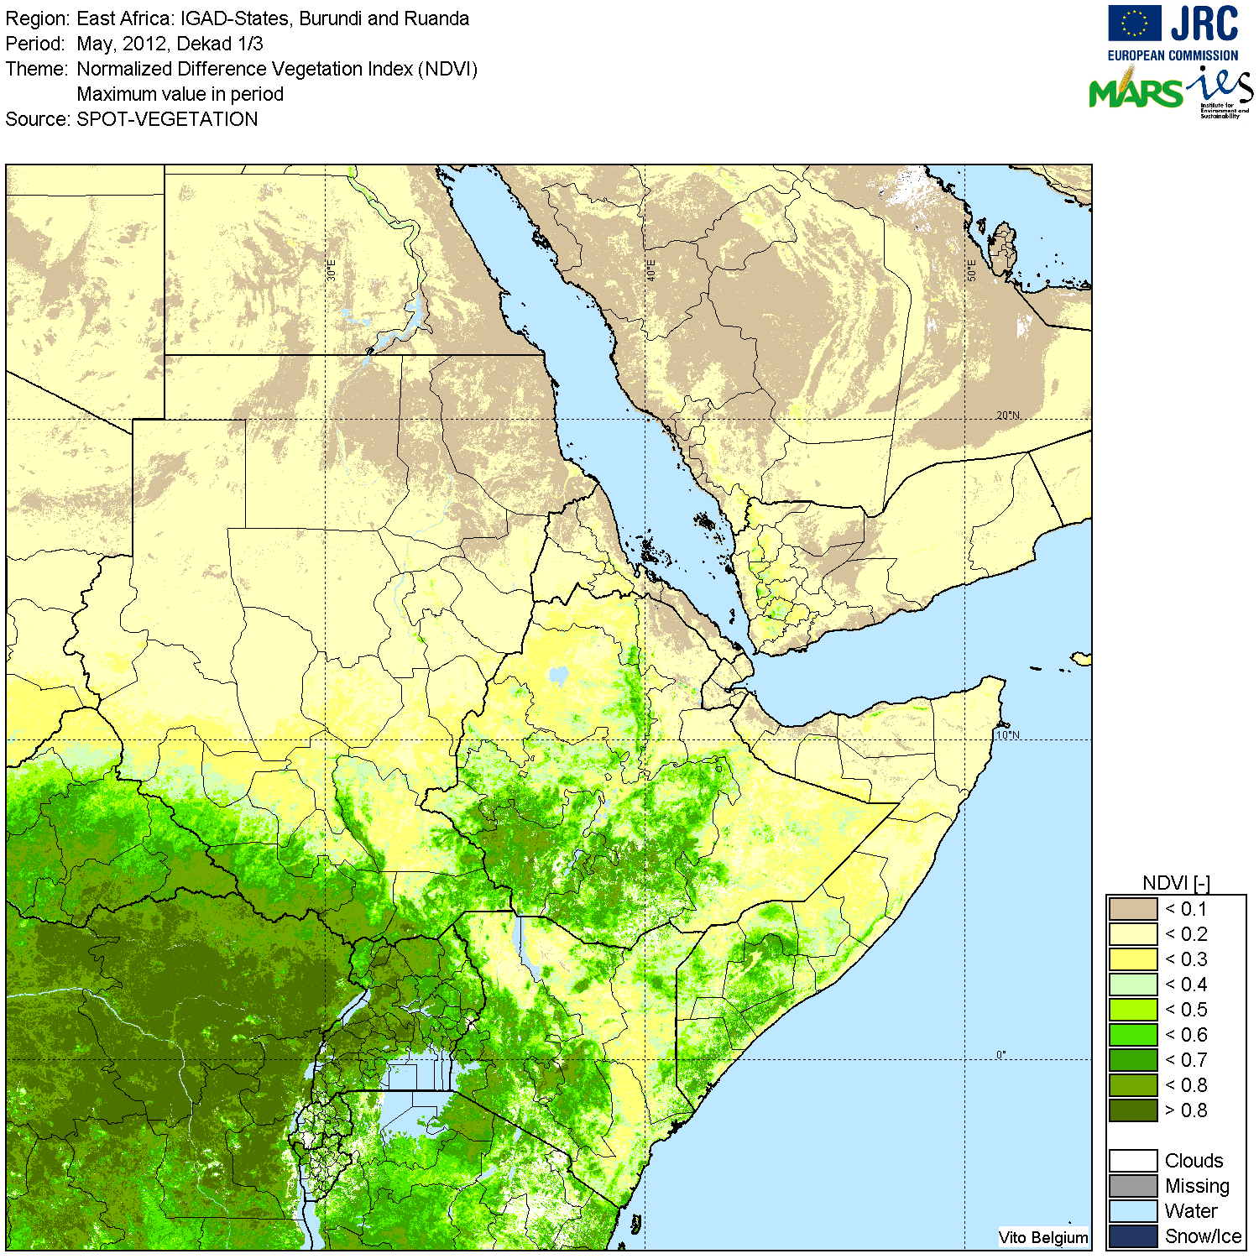
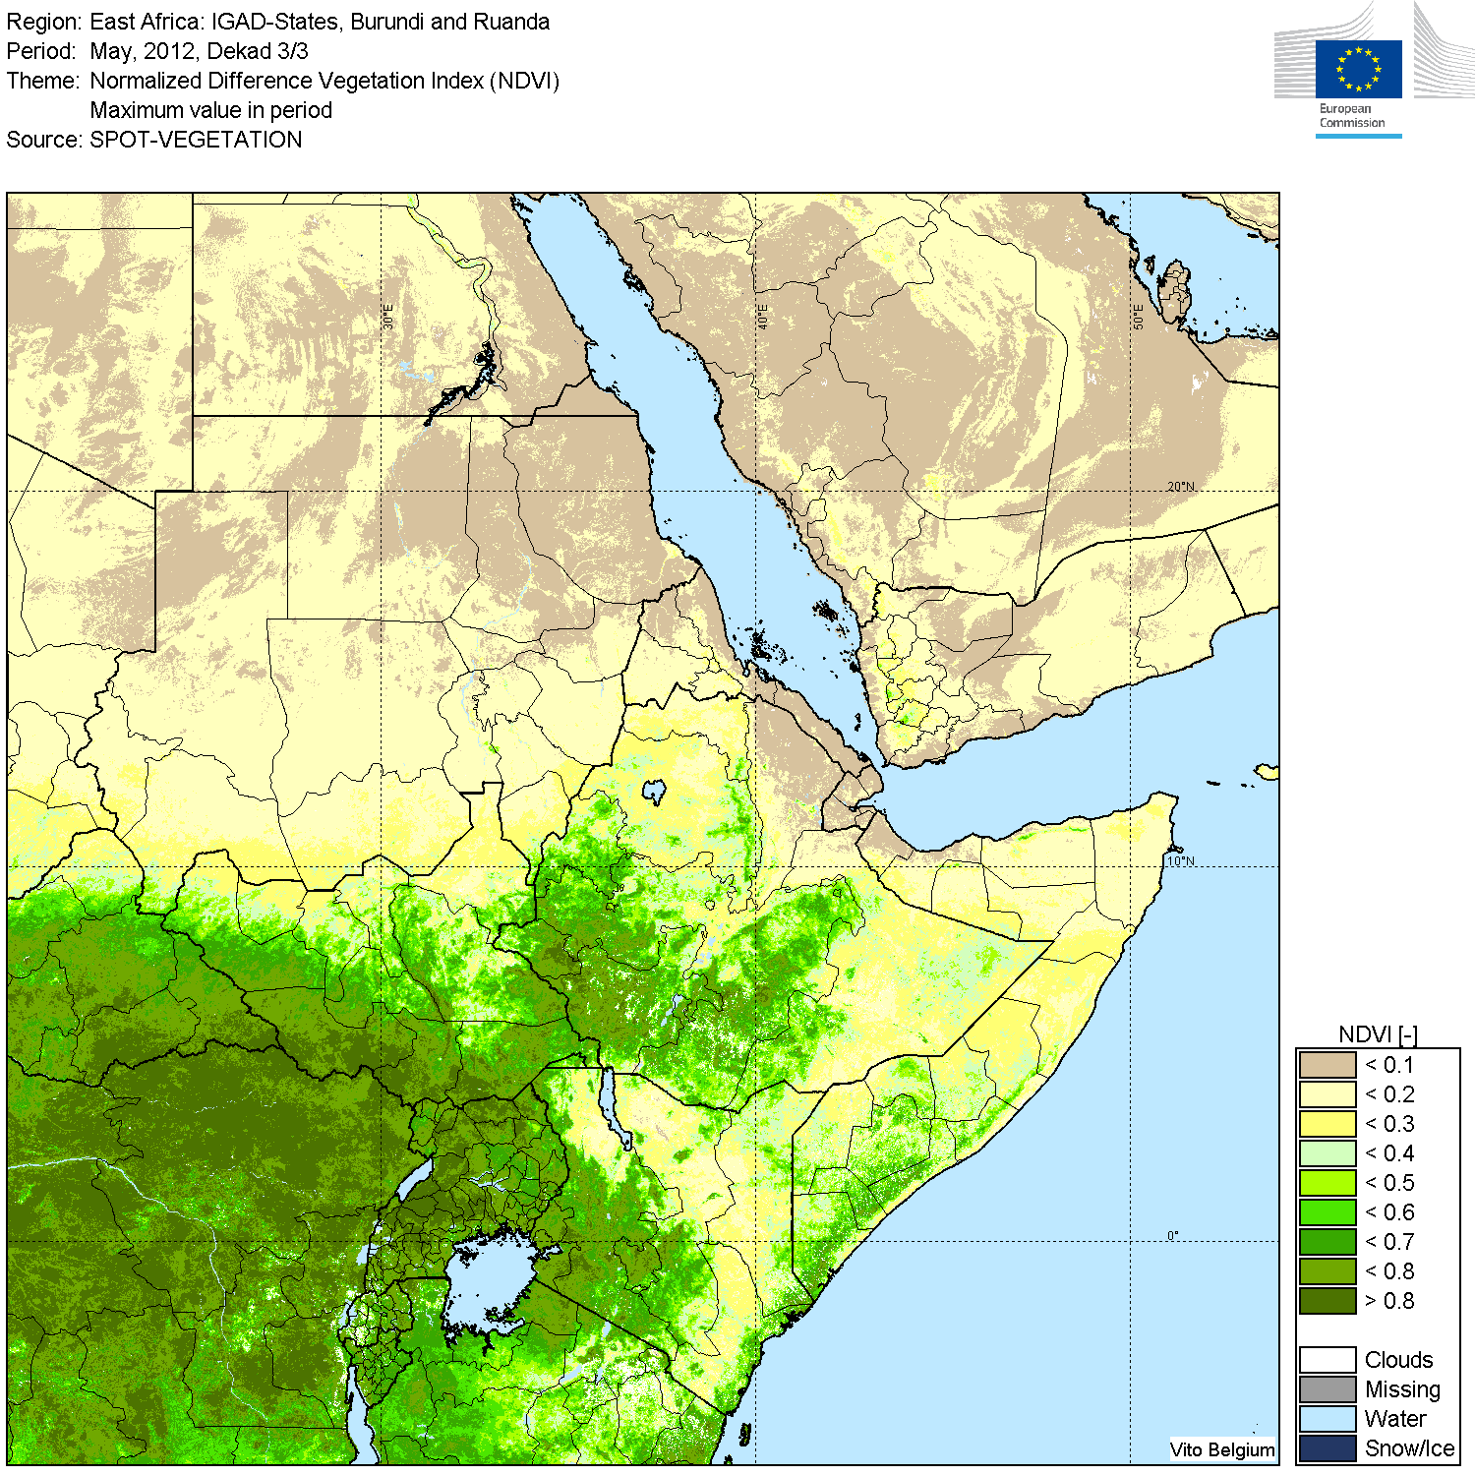
Some General Modifications
New logo
Boundaries of Sudan adapted on QuickLooks
OLD NEW
Update of “Historical Year”
For SPOT-VGT (1999-2012=14yr), NOAA-AVHRR (1982-2012=31 yr)
Not (yet) for MSG, METOP and MODIS

Slide 8
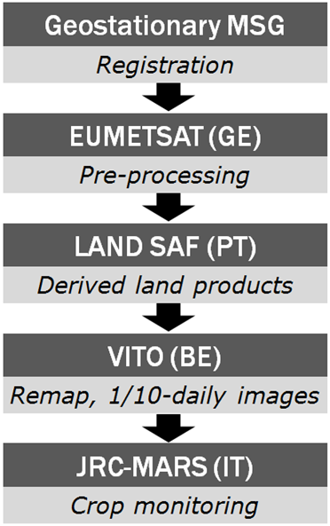
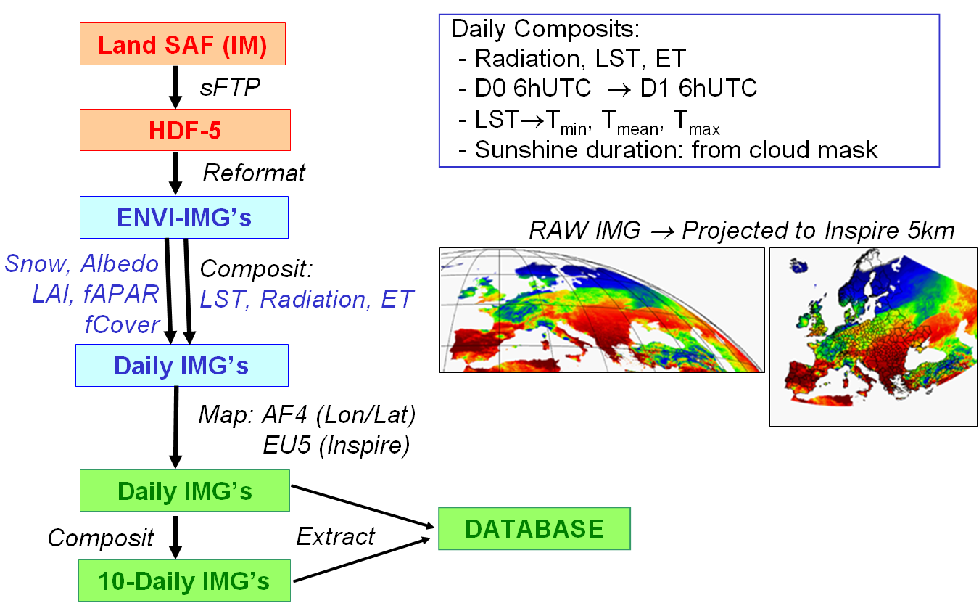
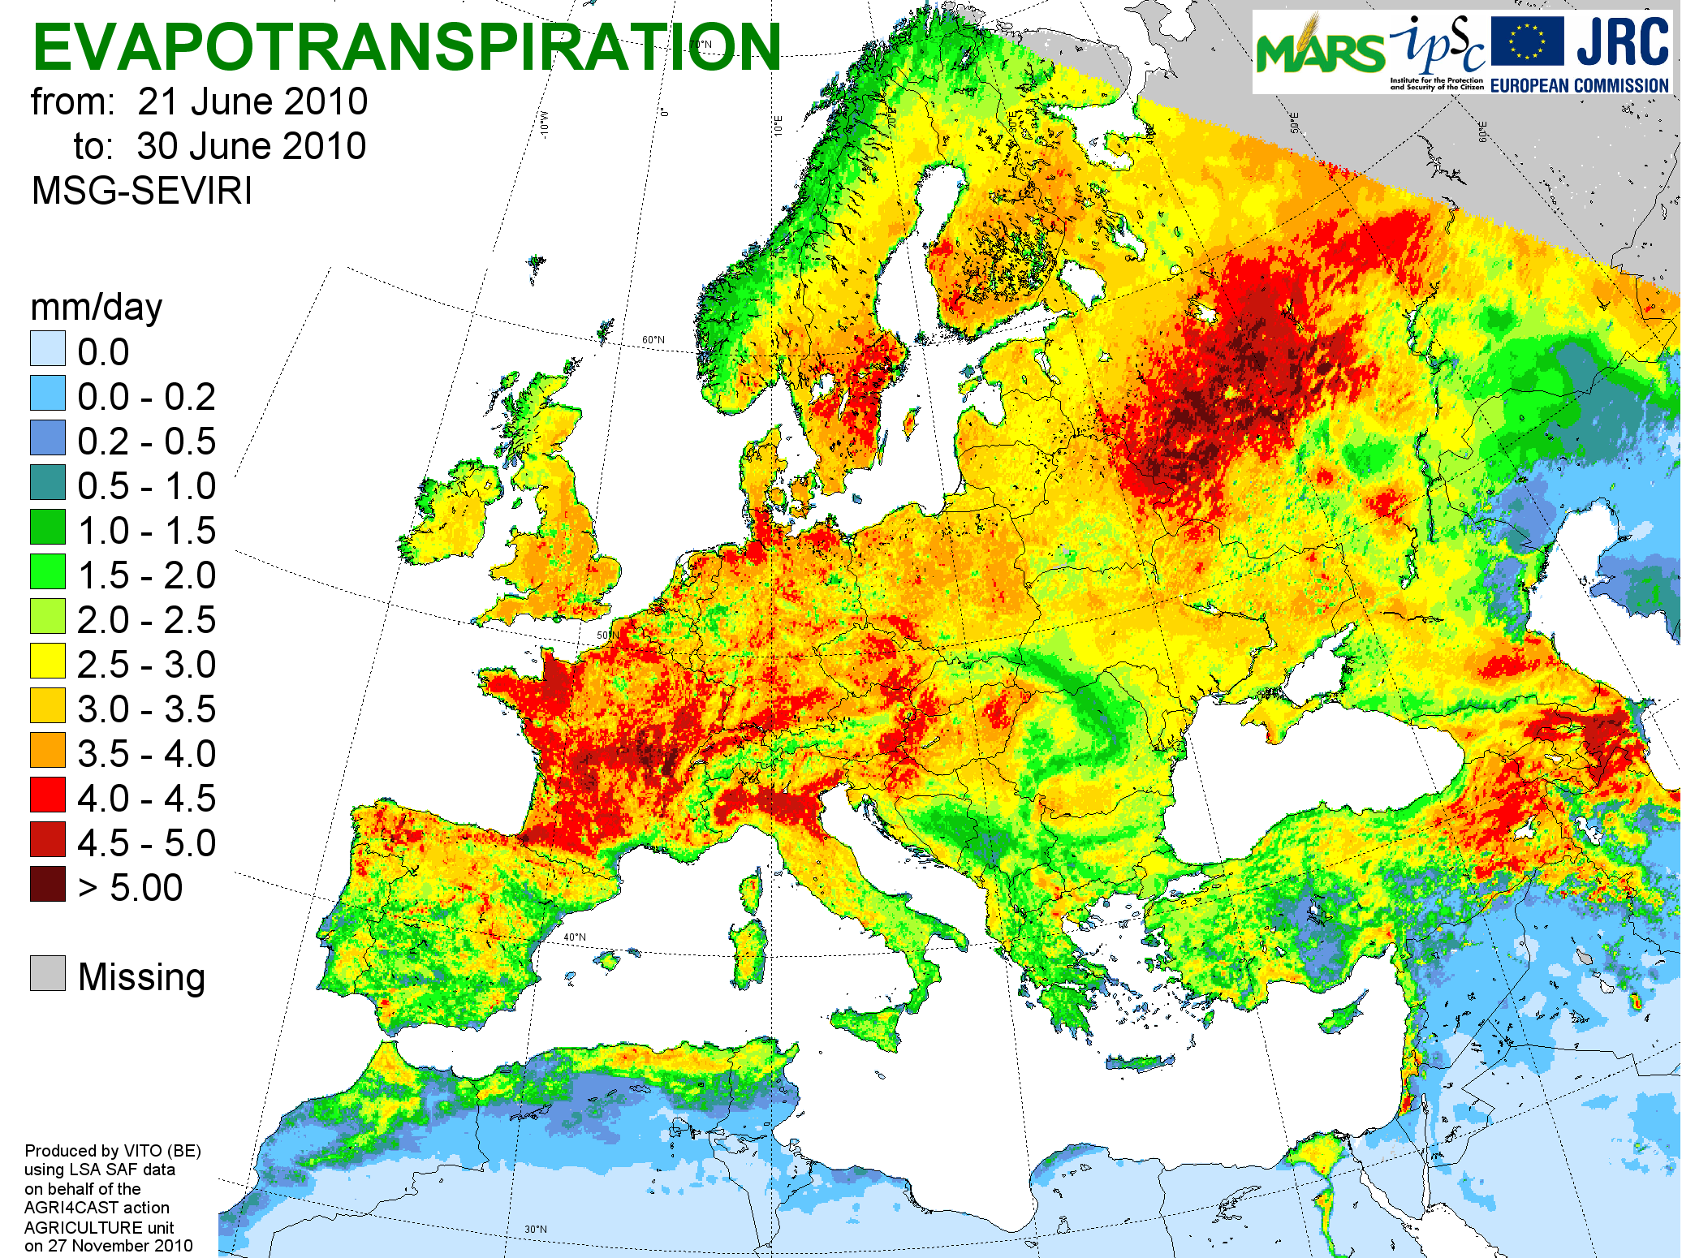
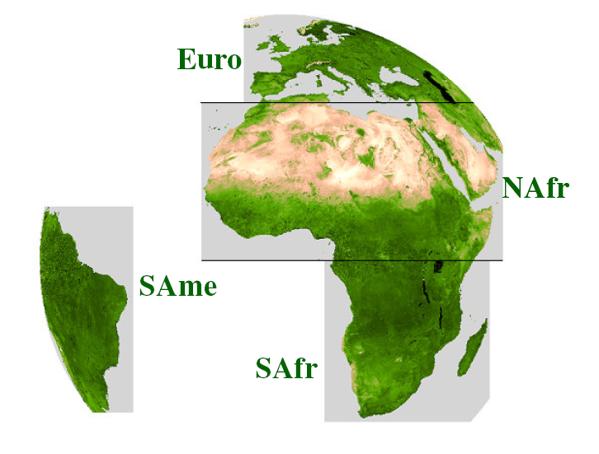
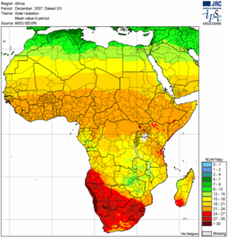
MSG-SEVIRI (T2)
Basic chain at VITO (AseMARS 2005)
Four zones of LSA SAF
AF4: Africa at 4 km
EU5: Europe at 5 km

Slide 9
MSG-SEVIRI (T2): Remarks
Some data gaps
Transition CDOP1 → CDOP2
CDOP2 includes full reprocessing of archives
⇒ Fill data gaps or …
⇒ Wait for final data
Inject solar radiation (DSSF) in CGMS?

Slide 10
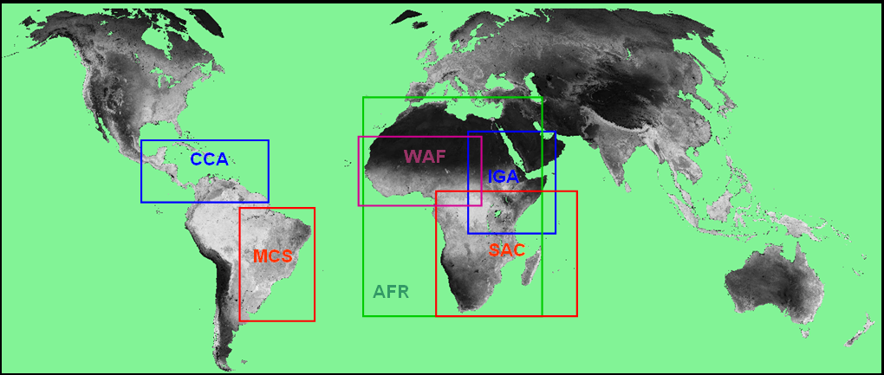
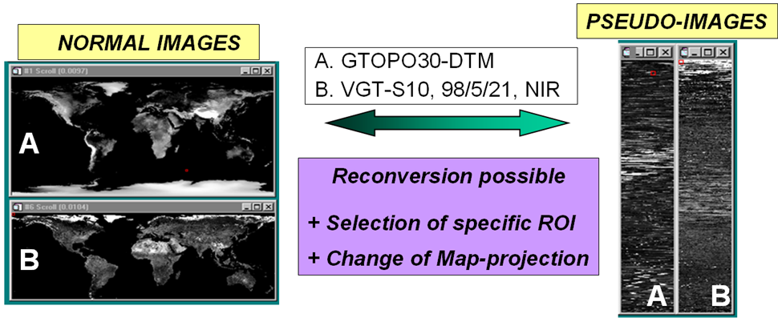
Global SPOT-VGT (T8): Processing
ROIs
GPI: Global, 1km, PI
GLD: Global, 21km, NI
1km NI: AFR, IGA, WAF, SAC, MCS, CCA
STATUS
Fully operational
Global S10-composites acquired from CTIV
Feb. 2011: Historical year updated (1999→2010)

Slide 11
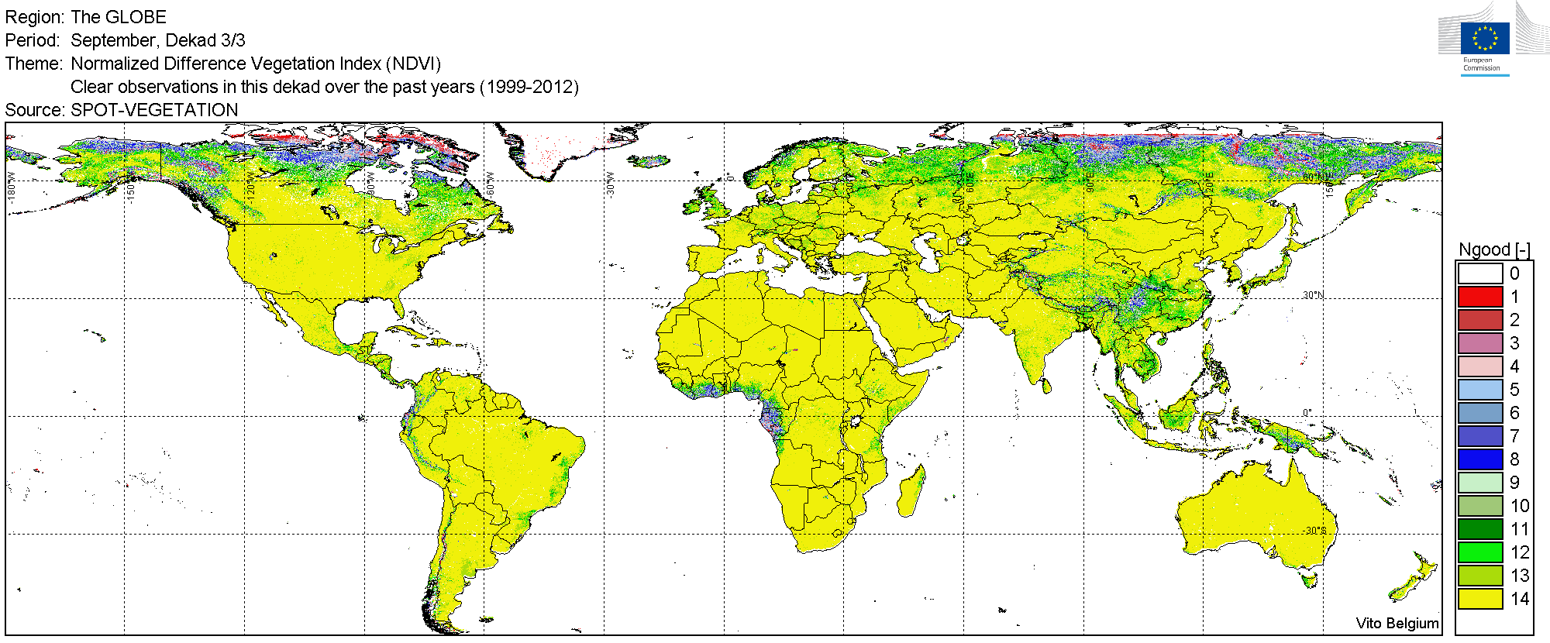
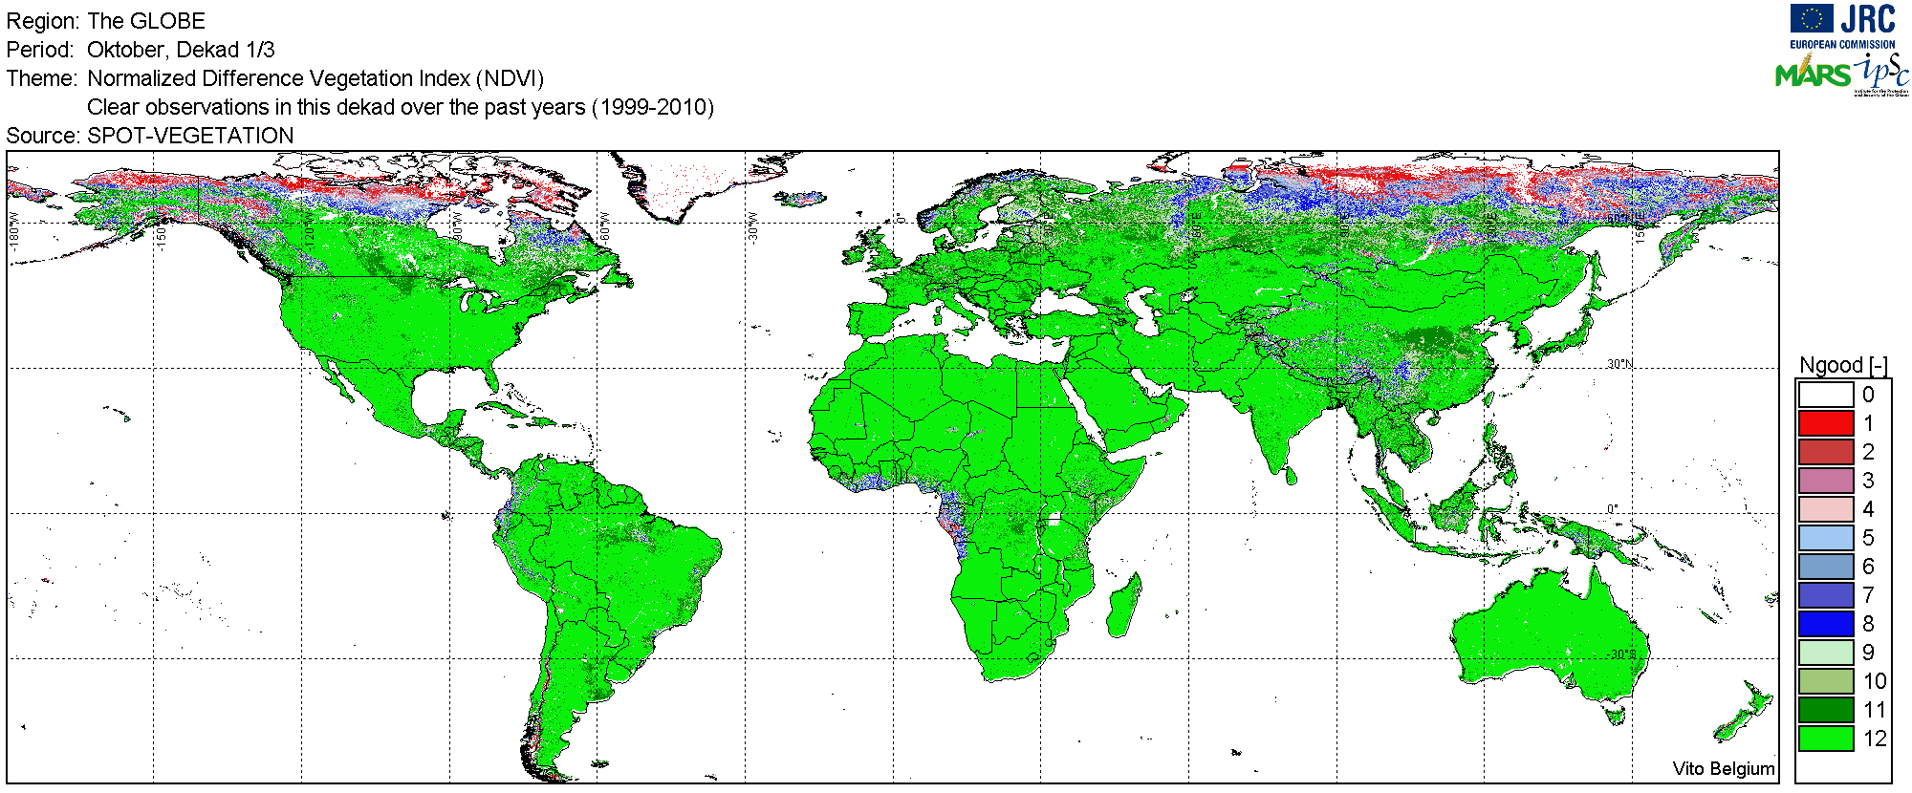
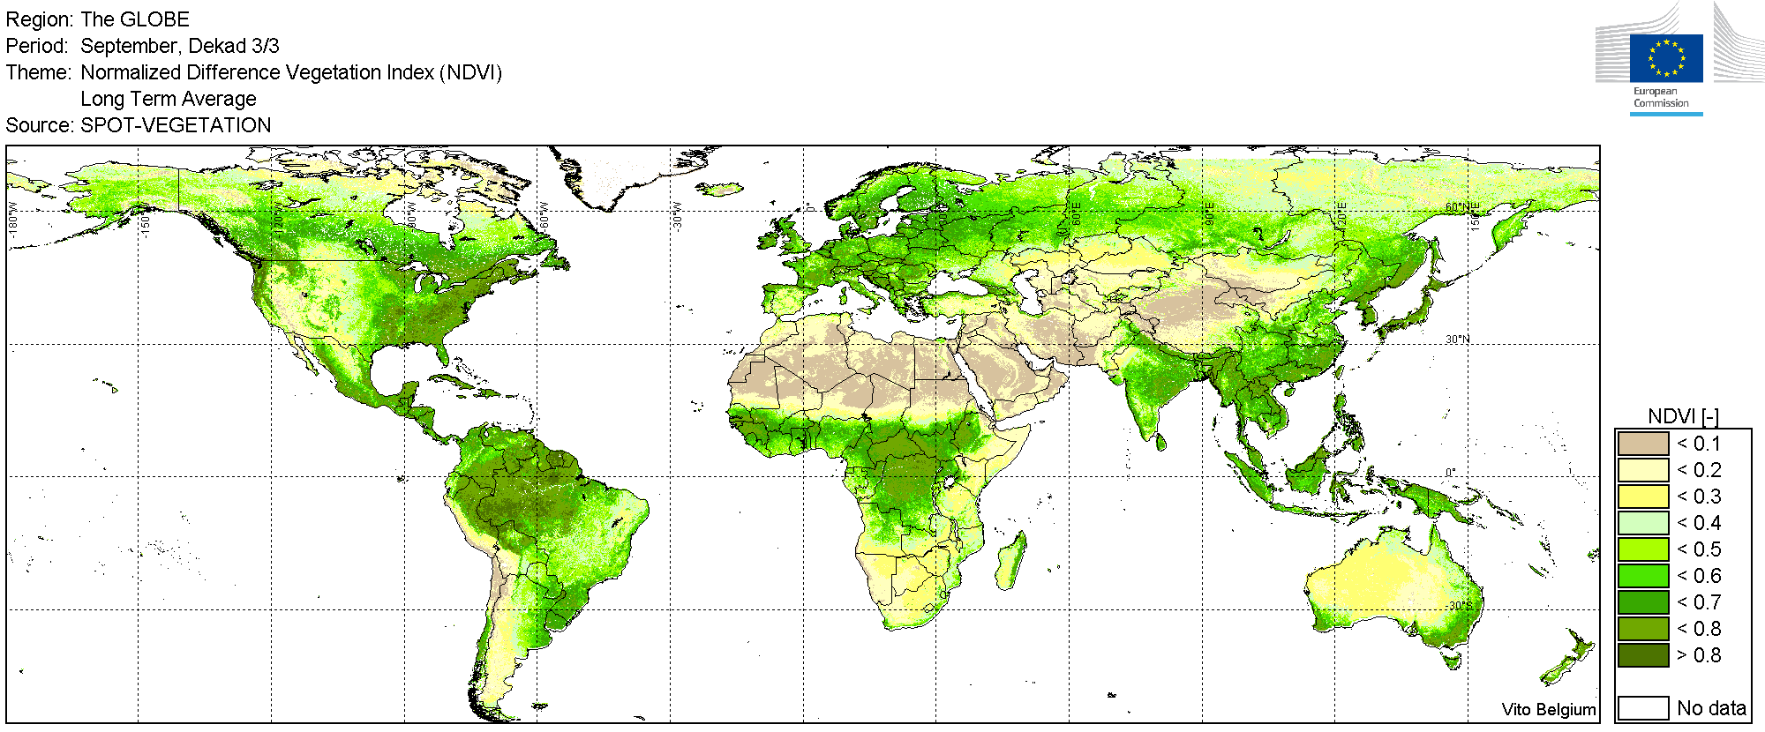
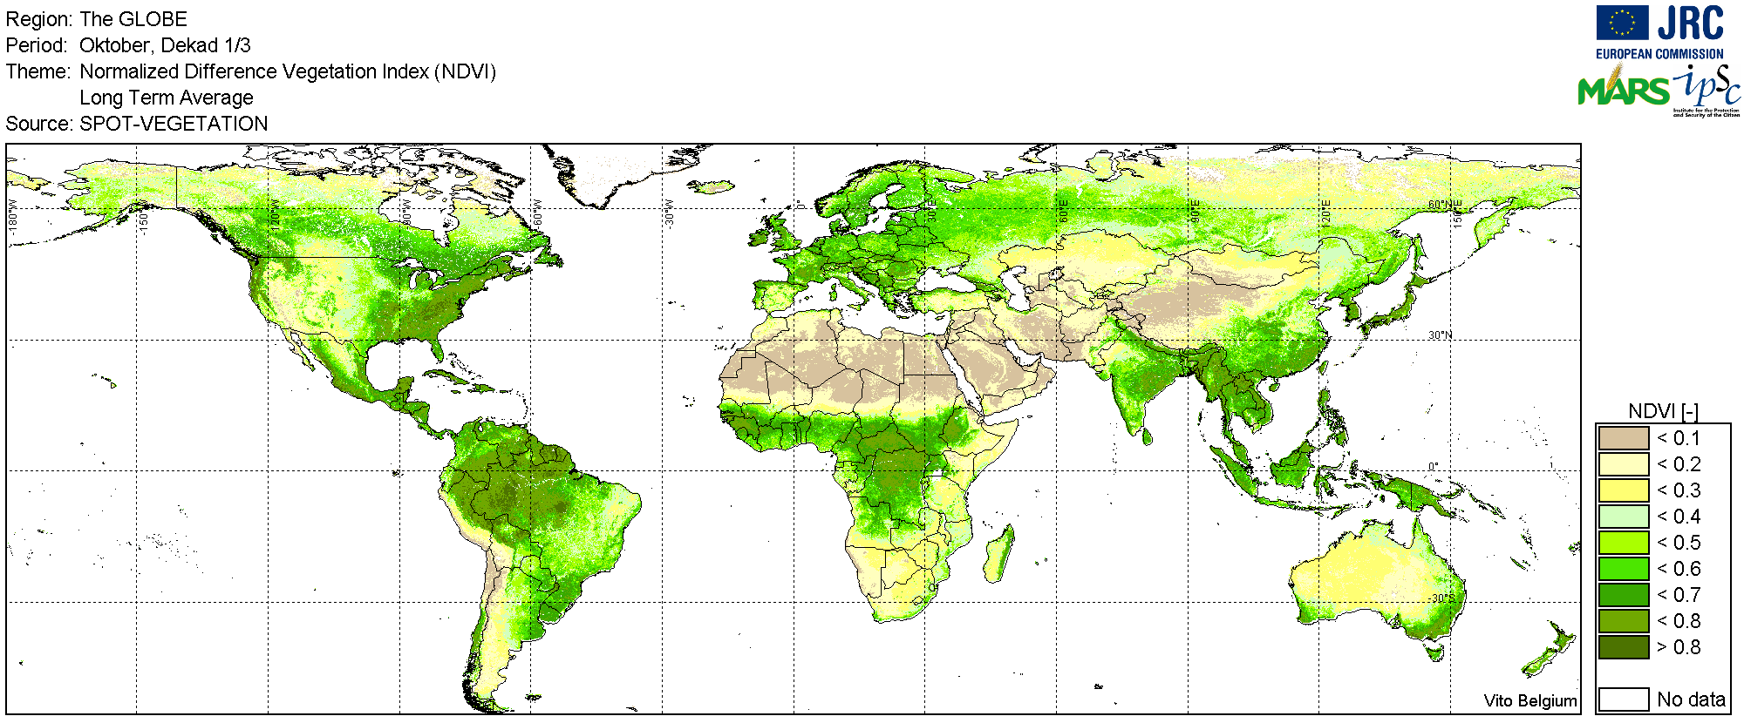
Global SPOT-VGT (T8): Update of Historical Year (1999-2012)
Dekad 27 (End September) Dekad 28 (Early October)
14 Years 1999-2012 12 Years 1999-2010
Good observations over 14/12 years
Mean NDVI

Slide 12
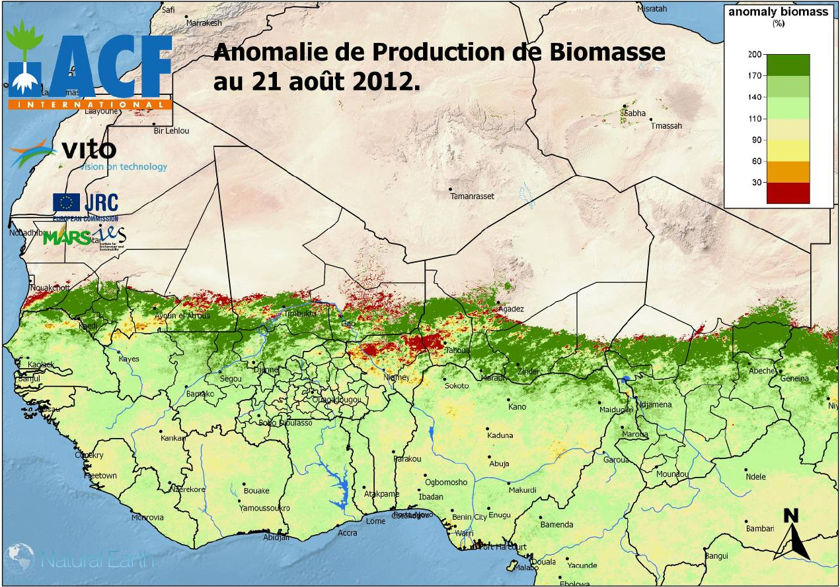
Global SPOT-VGT (T8): Deliveries to 3rd parties
GeoLand, DevCoCast, AgriCAB, ACH,…
Recent demand by USDA-FAS (Curt Reynolds) to get LTA-NDVI of global SPOT-VGT (36 dekads)

Slide 13
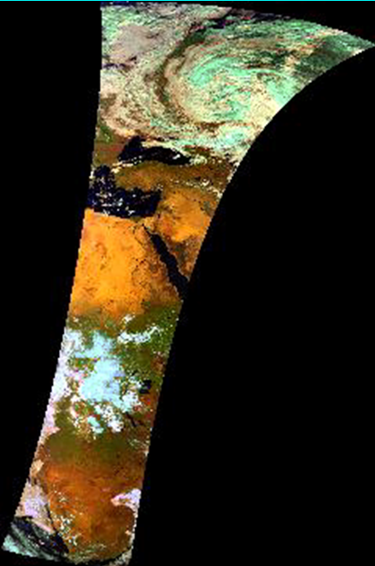
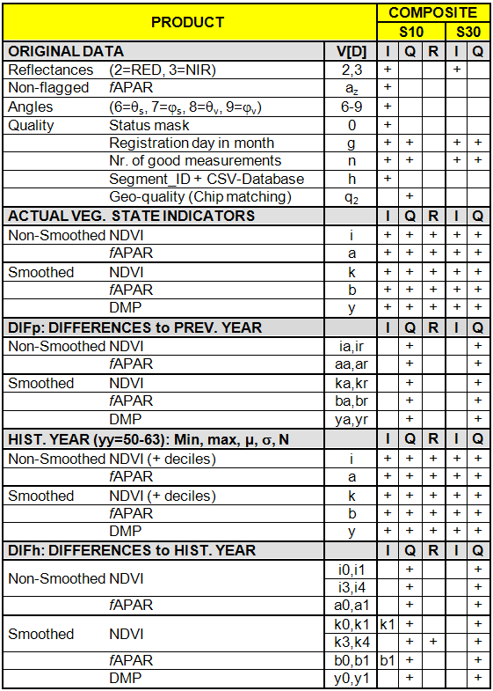
European SPOT-VGTp (T4)
Status
Fully operational
No problems
Smoothing?
Products table
Not shown: annual products (ISO, SIM)
VGTp-series starts in April 1998
5 “crucial” variables:
- non-smoothed i-NDVI, a-fAPAR
- smoothed k-NDVI, b-fAPAR, y-DMP
Historical Year based on 1999-2010 (12 years, same as for global VGT-S10)
RUM for 2 sets of regions (ADM/MET)

Slide 14
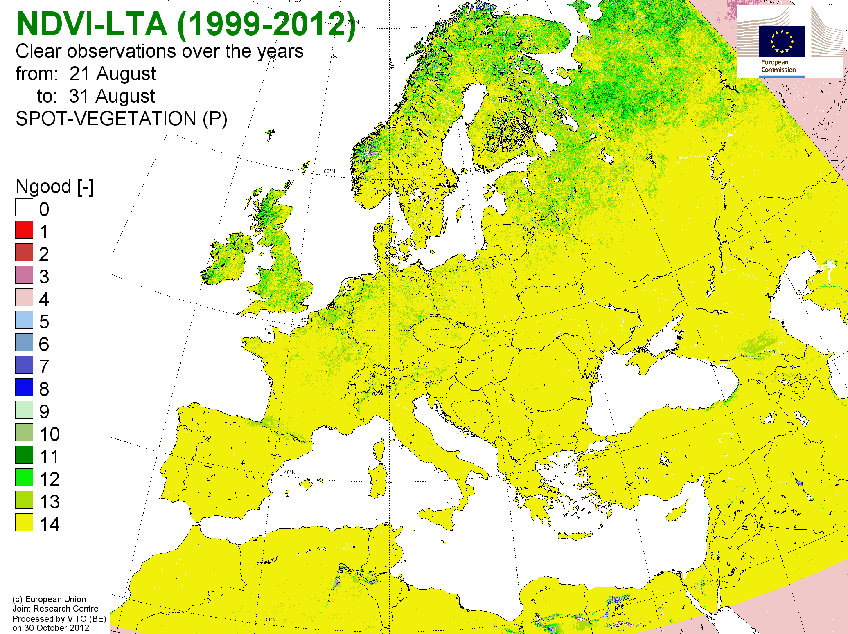
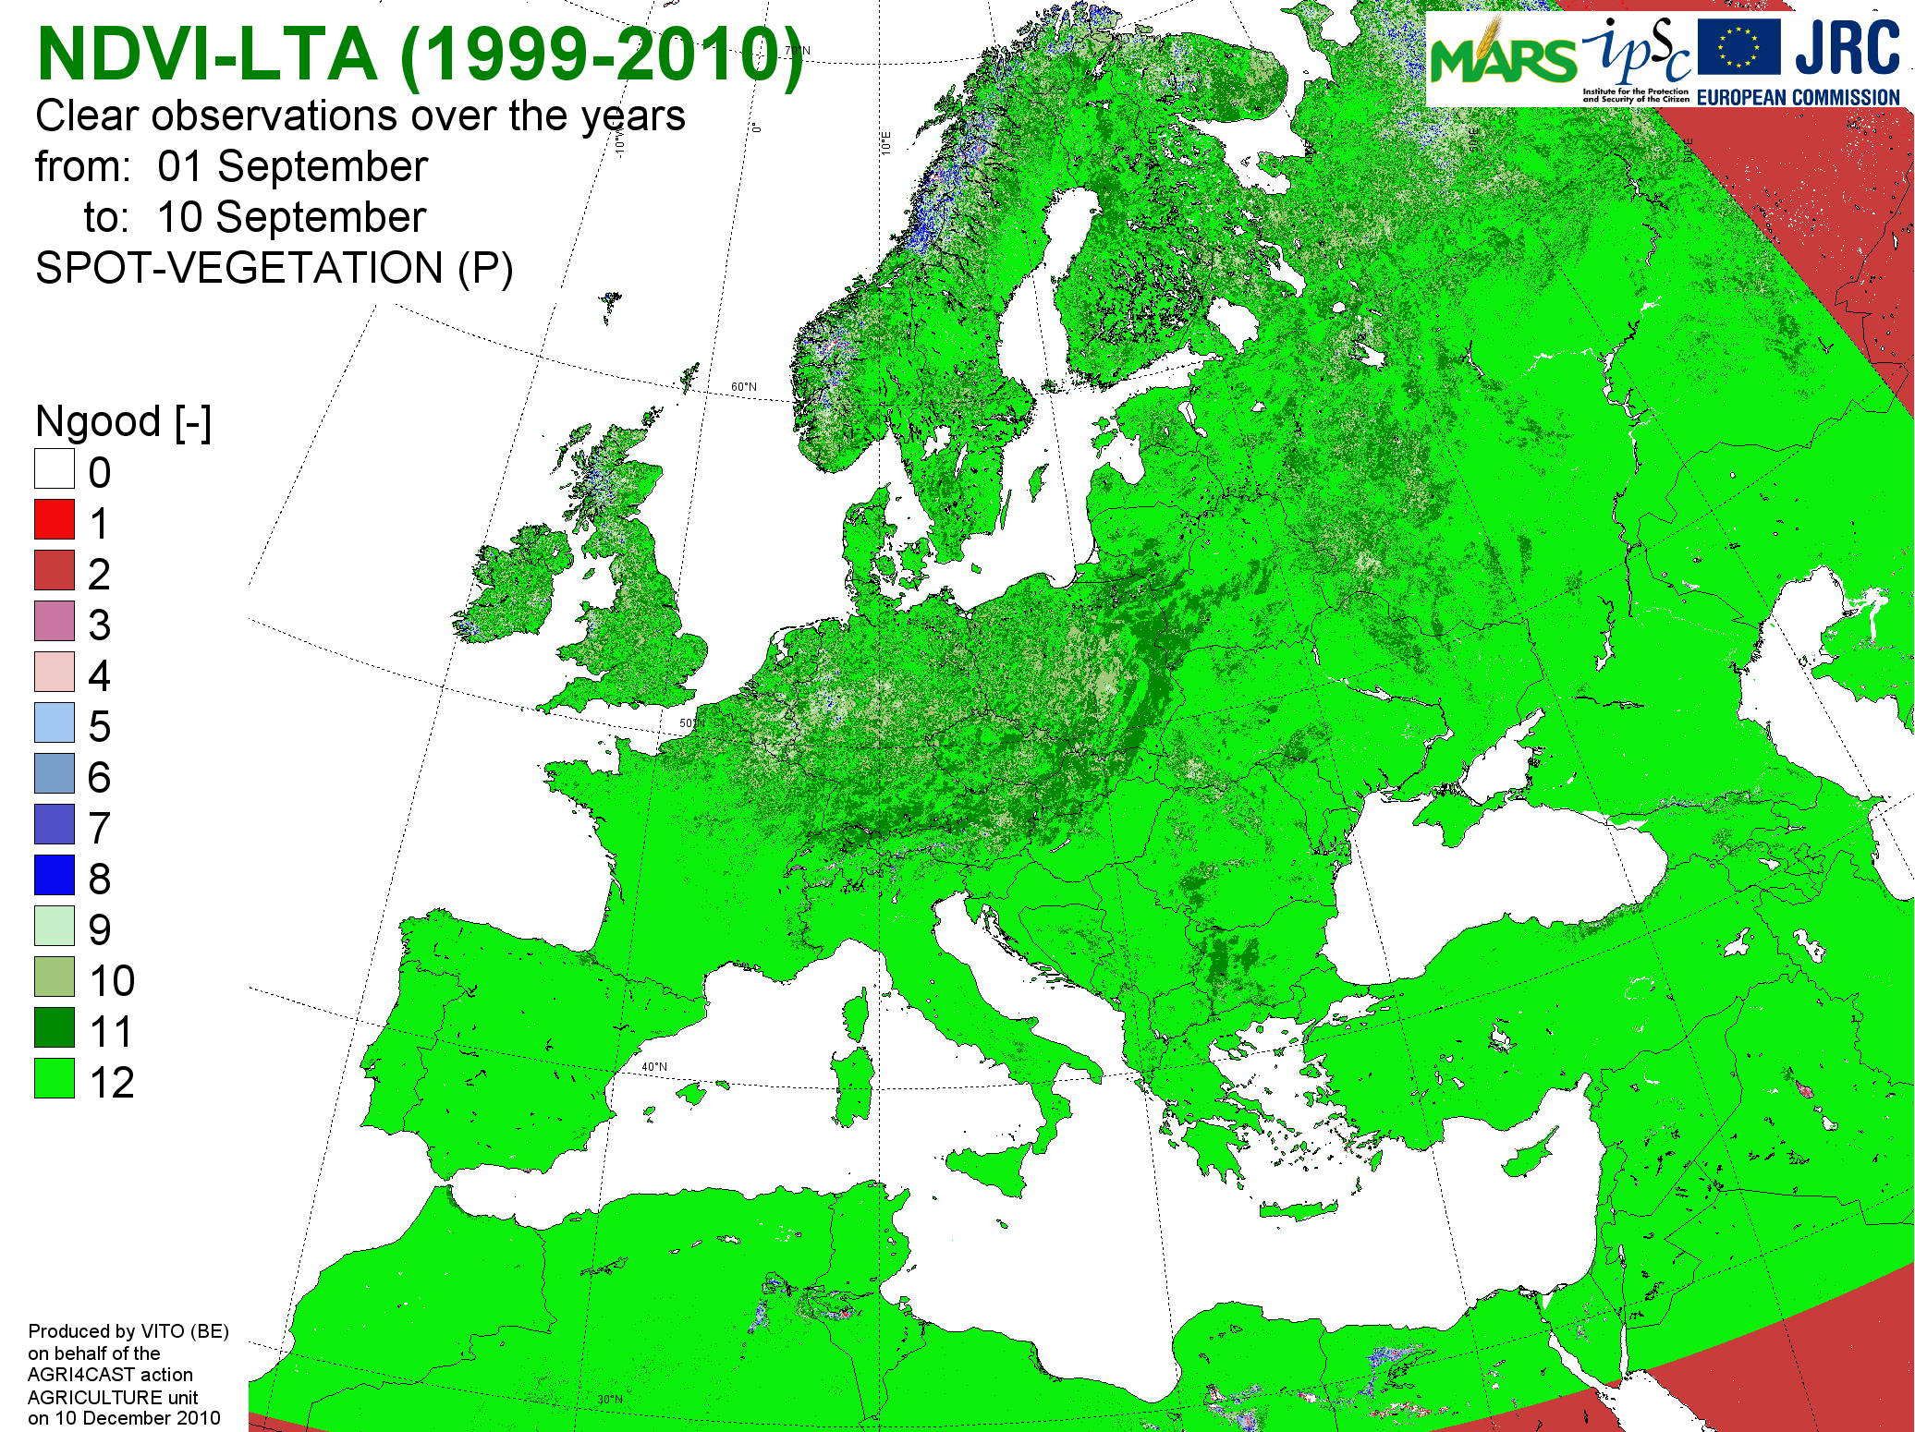
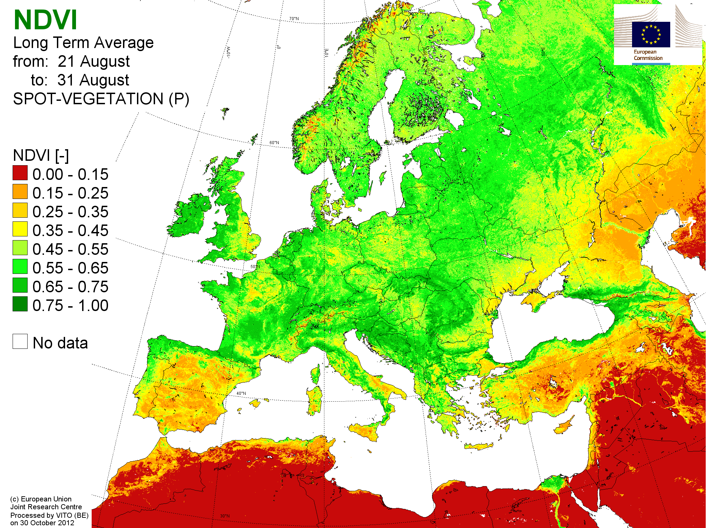
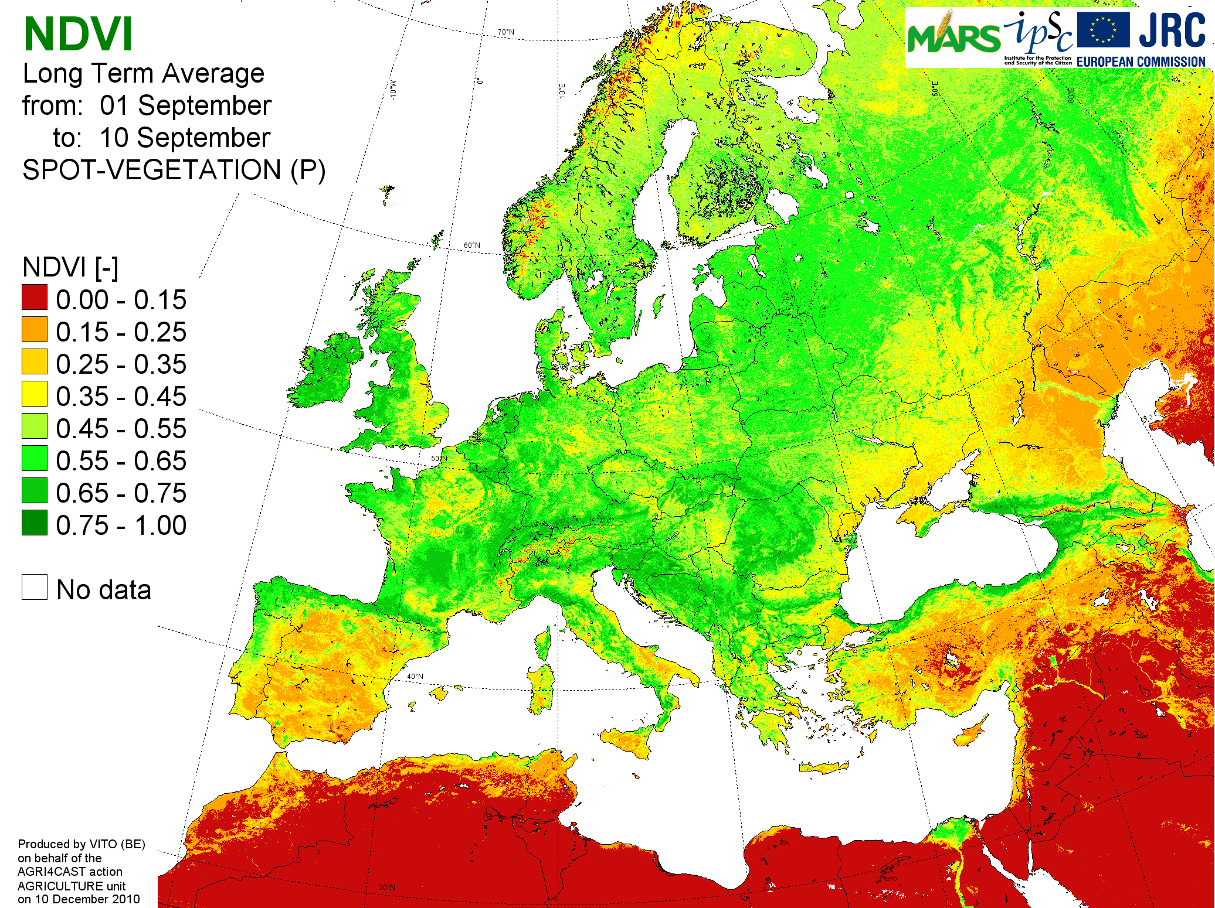
European SPOT-VGTp (T4): Update of Historical Year (1999-2012)
Dekad 24 (End August) Dekad 25 (Early September)
14 Years 1999-2012 12 Years 1999-2010
Good
observations
over
14/12 years
Mean
NDVI

Slide 15
SPOT-VGT (T4/T8): General remarks
Some errors identified in pre-processing by CTIV:
Geo-correction of data of 1998
Maybe some remaining calibration errors?
Some S10 contain info from days before/after dekad
Recent: error in correction Earth-Sun distance
CTIV-Planning:
Continue VGT-mission until 2014
Afterwards: error-free reprocessing of entire archive
Personal note:
No other Earth Observation system is followed with as much criticism/suspicion as SPOT-VGT.
Let’s do the same for all the others (MODIS, NOAA,…).

Slide 16
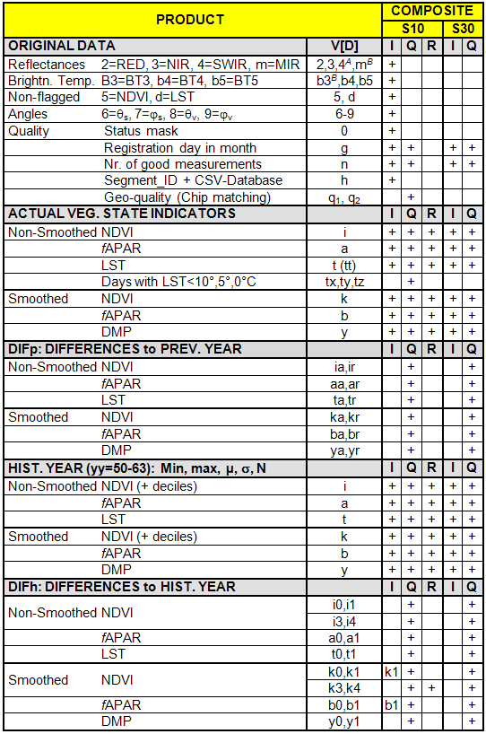
European NOAA-AVHRR (T3)
Status
Fully operational
No major problems
NOAA-20 ???
Products table (no changes)
Not included: ISOclus, simili
Series starts in August 1981
6 “crucial” variables:
- non-smoothed i-NDVI, a-fAPAR, t-LST
- smoothed k-NDVI, b-fAPAR, y-DMP
Historical Year based on 1982-2010 (29 years)
RUM for 2 regions (ADM/MET)
June: Full archive (2 TB) sent to BOKU-Vienna (Anja Klisch)

Slide 17
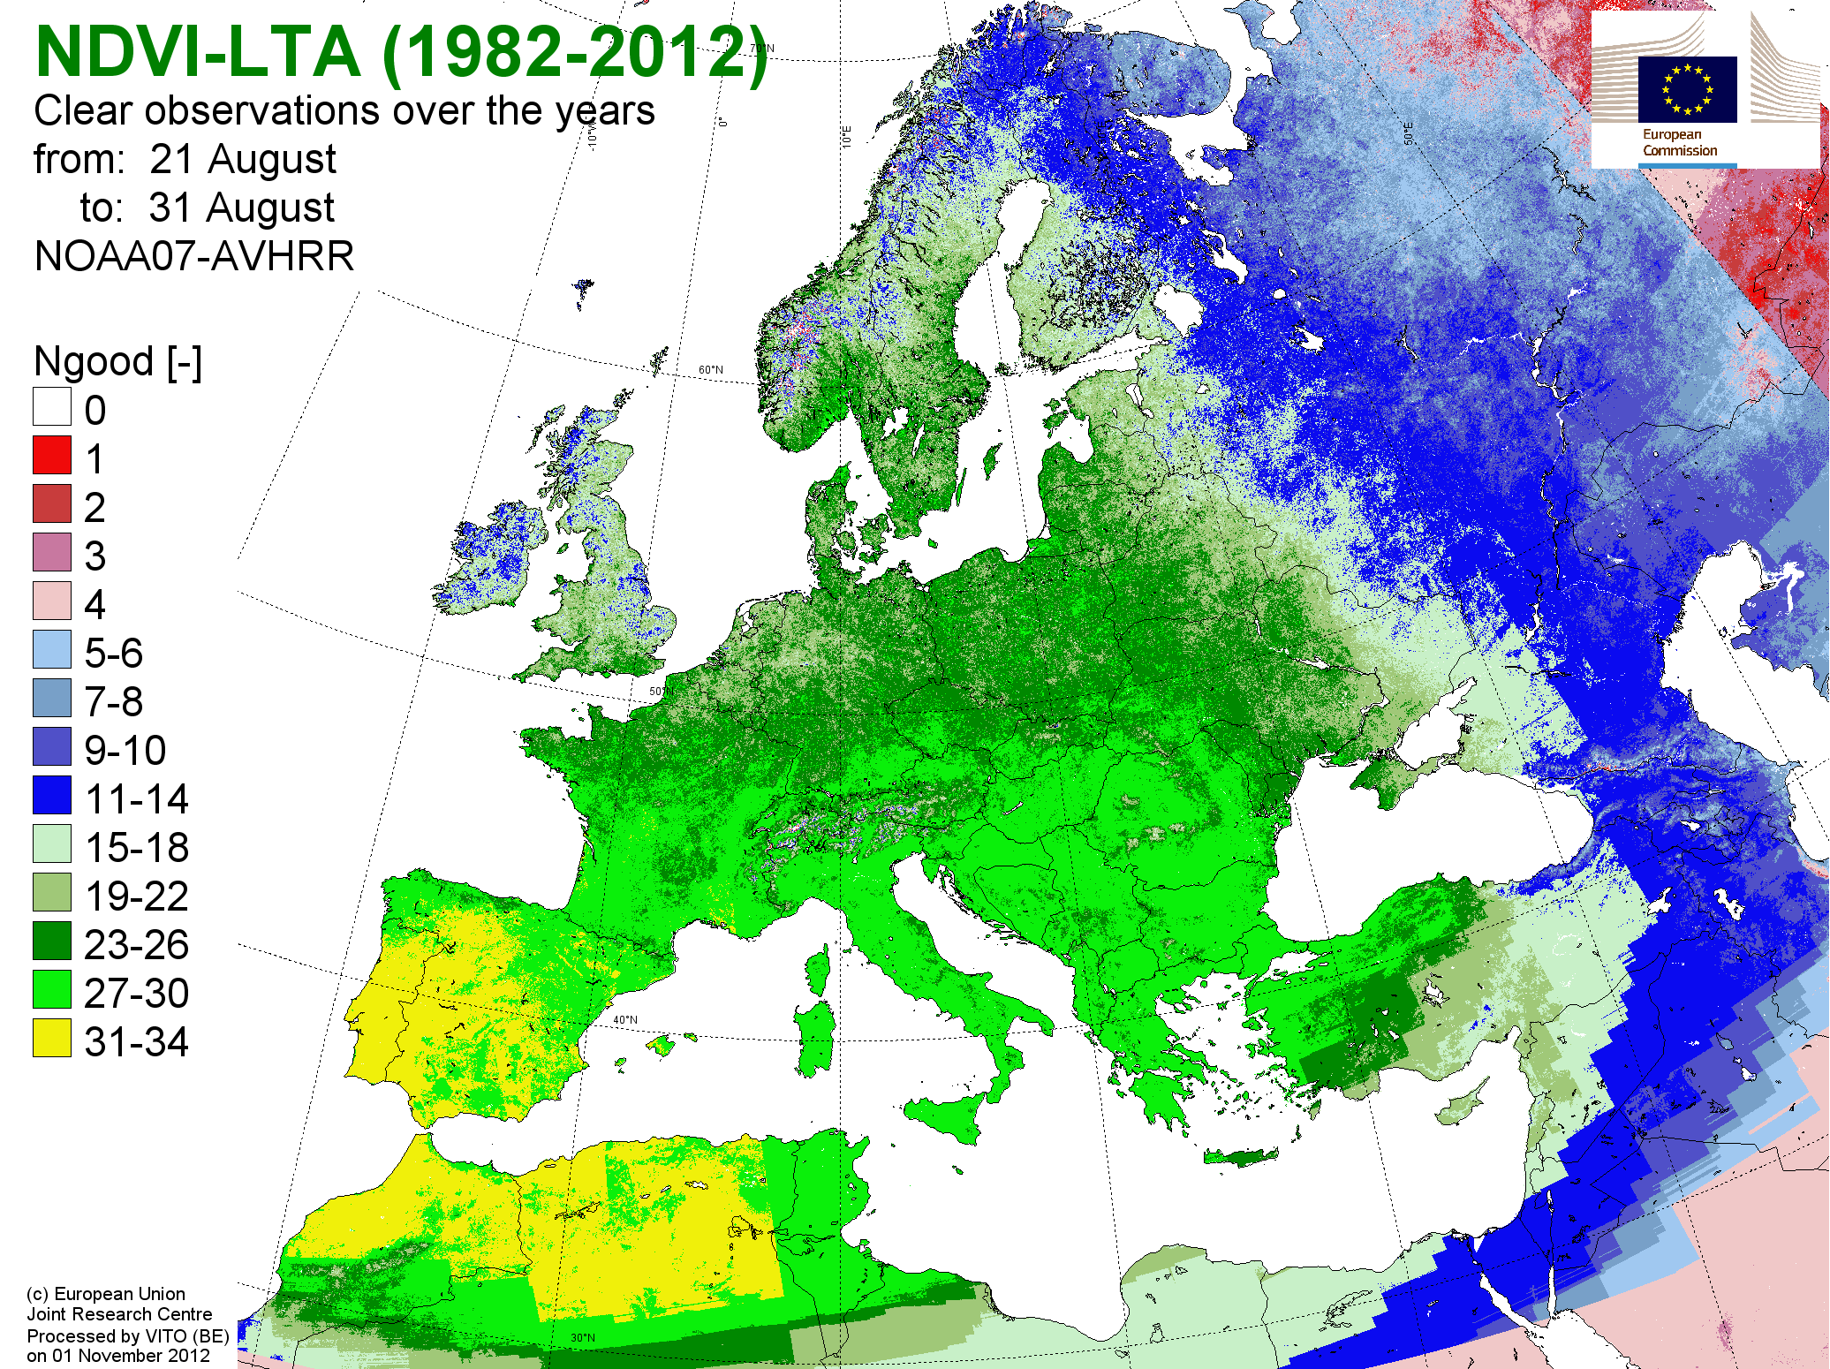
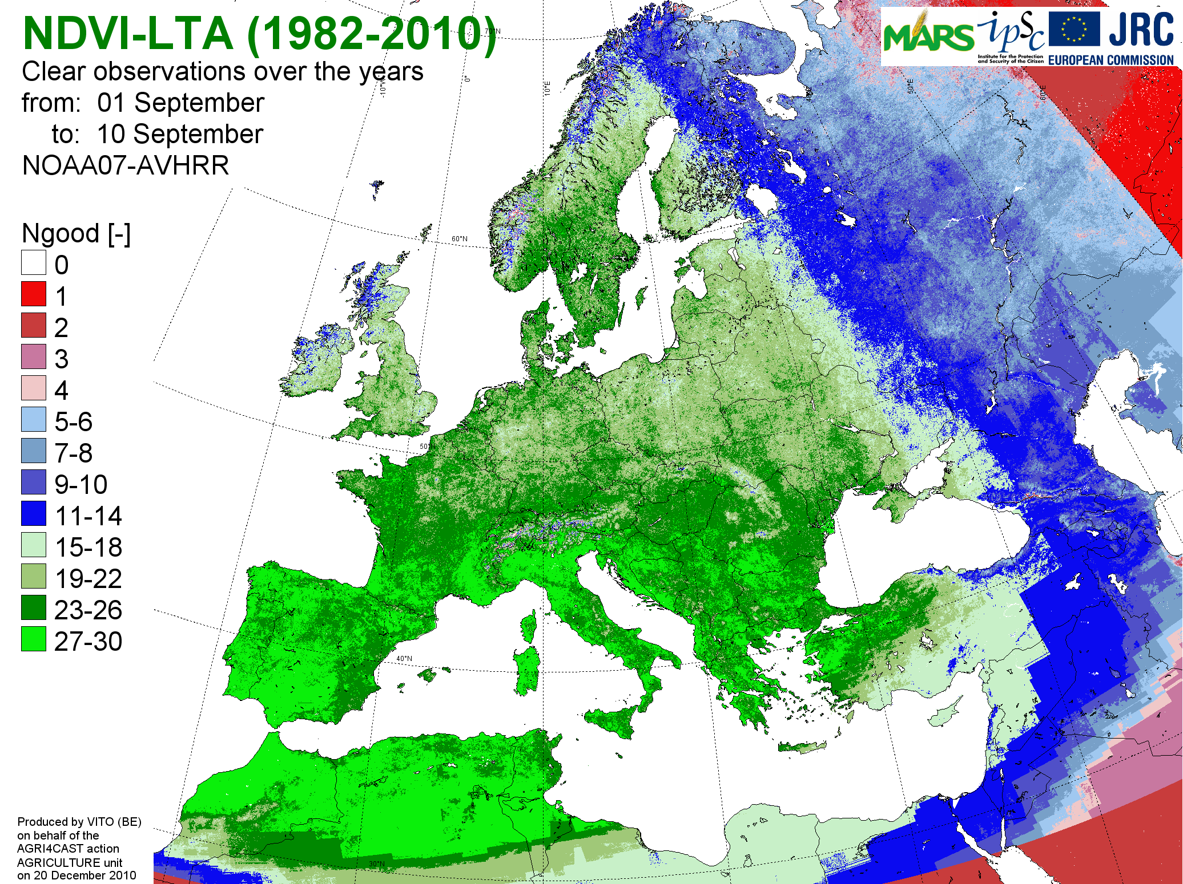
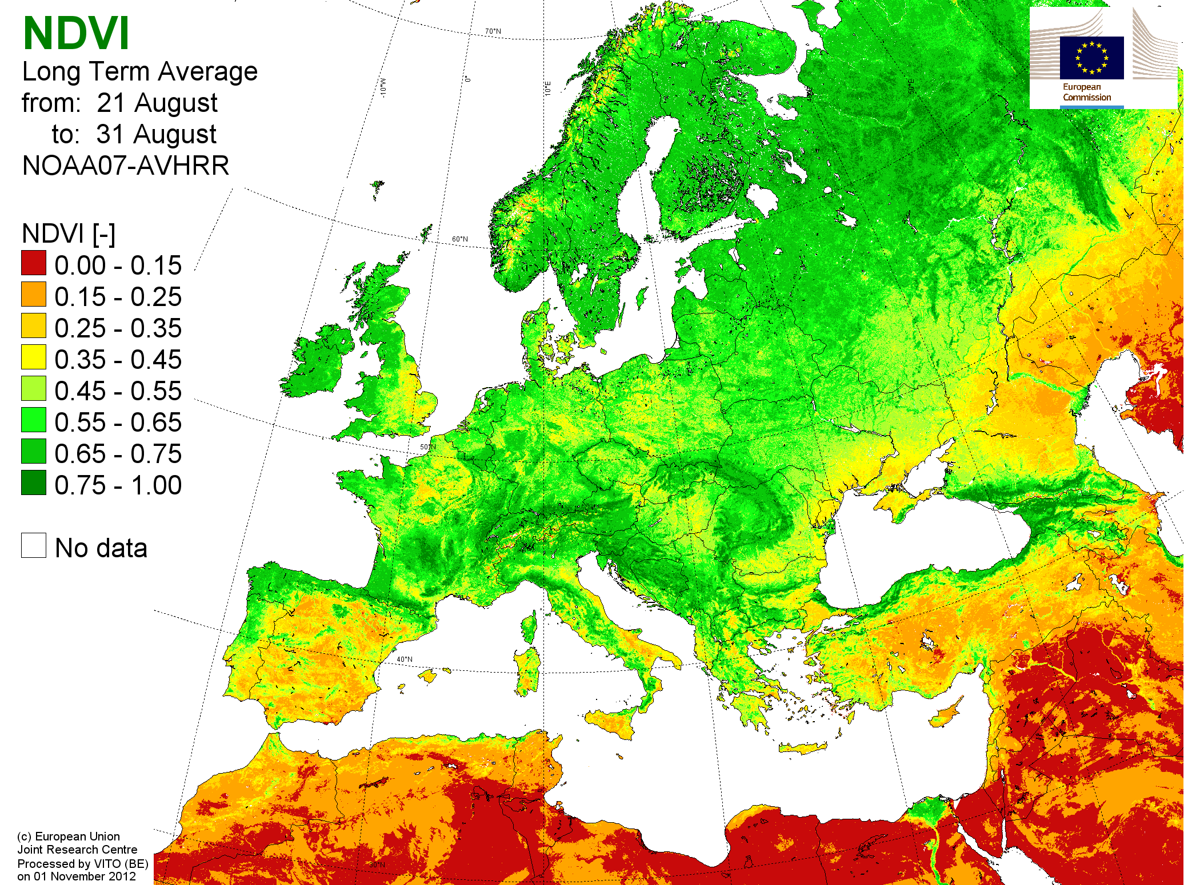
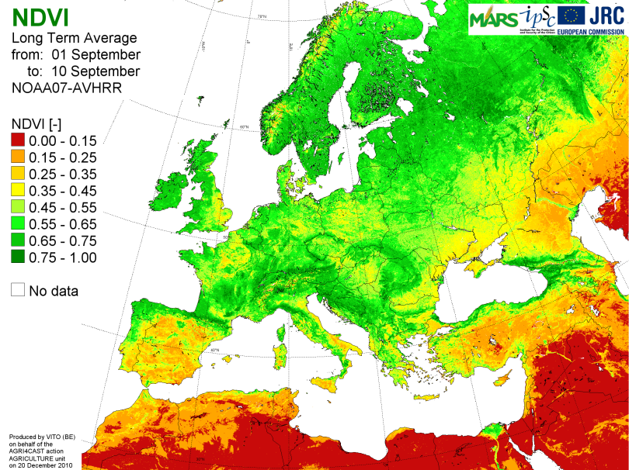
European NOAA-AVHRR (T3): Update of Historical Year (1999-2012)
Dekad 24 (End August) Dekad 25 (Early September)
31 Years 1982-2012 29 Years 1982-2010
Good
observations
over
31/29 years
Mean
NDVI

Slide 18
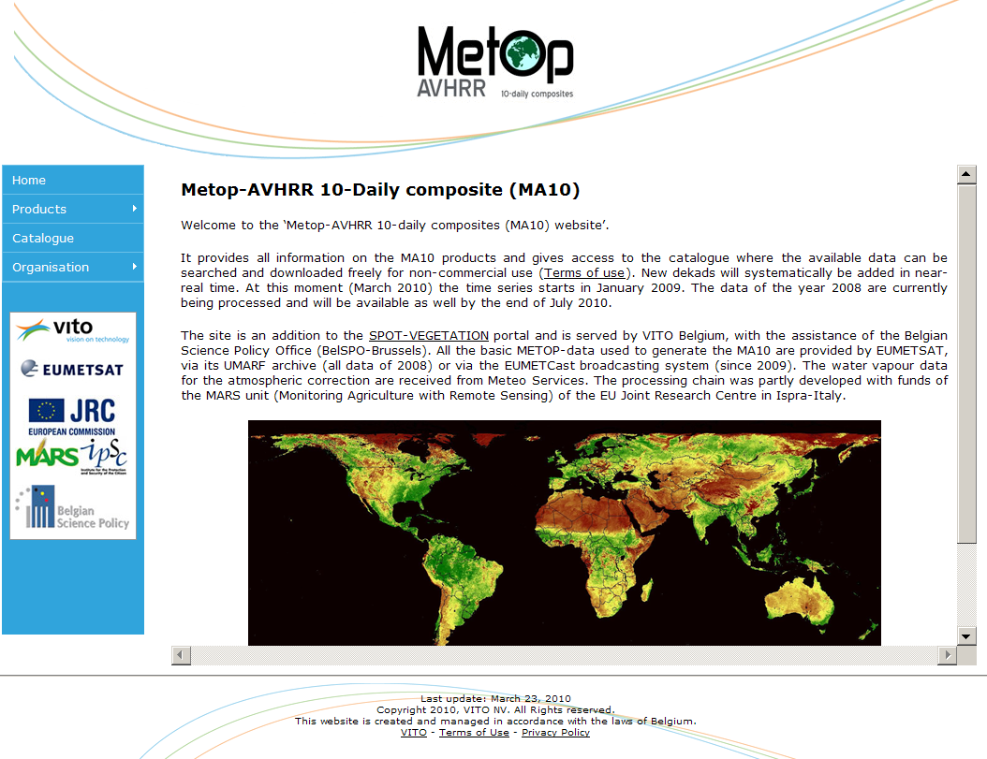
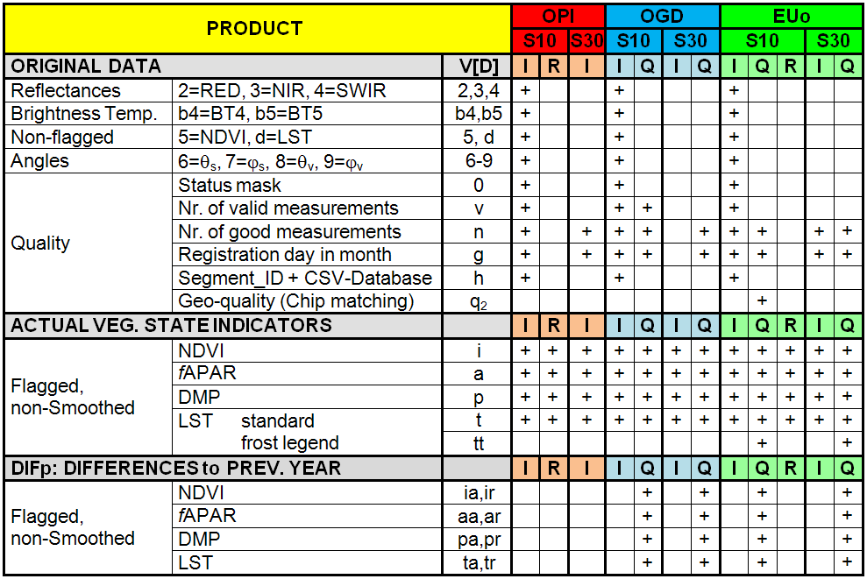
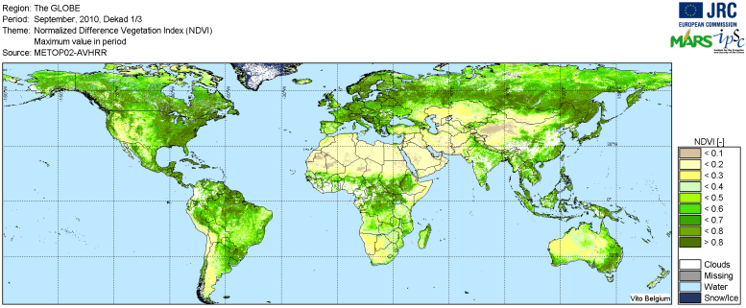
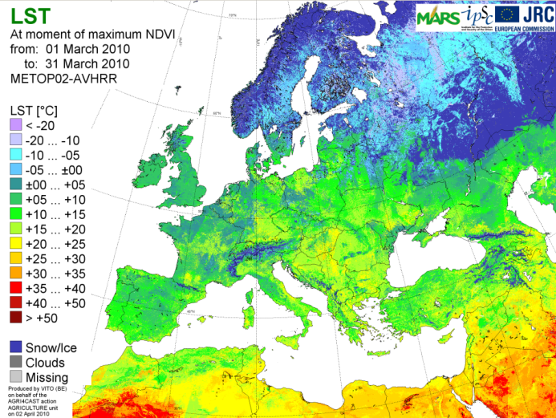
METOP-AVHRR (T5/T8)
NB: Series starts in dekad 8 of 2007 (so today > six years)

Slide 19
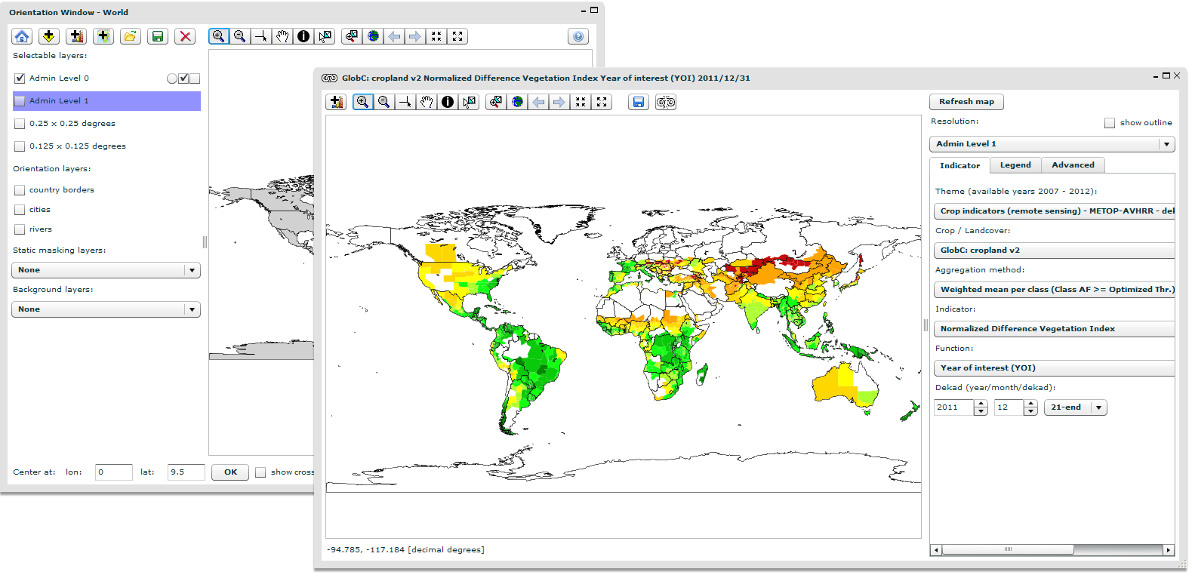
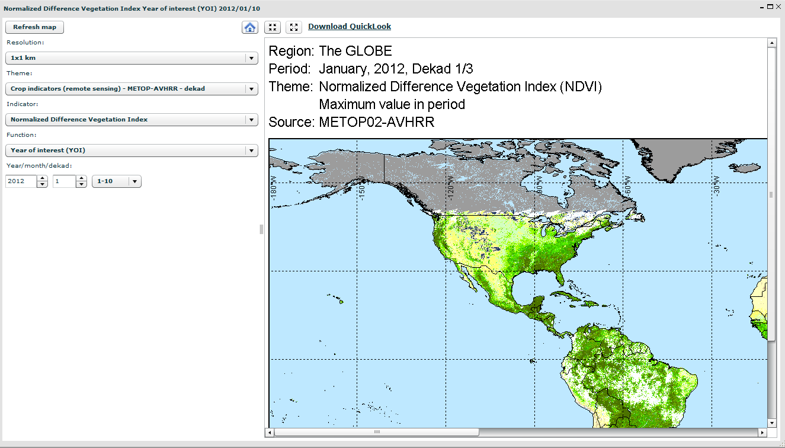
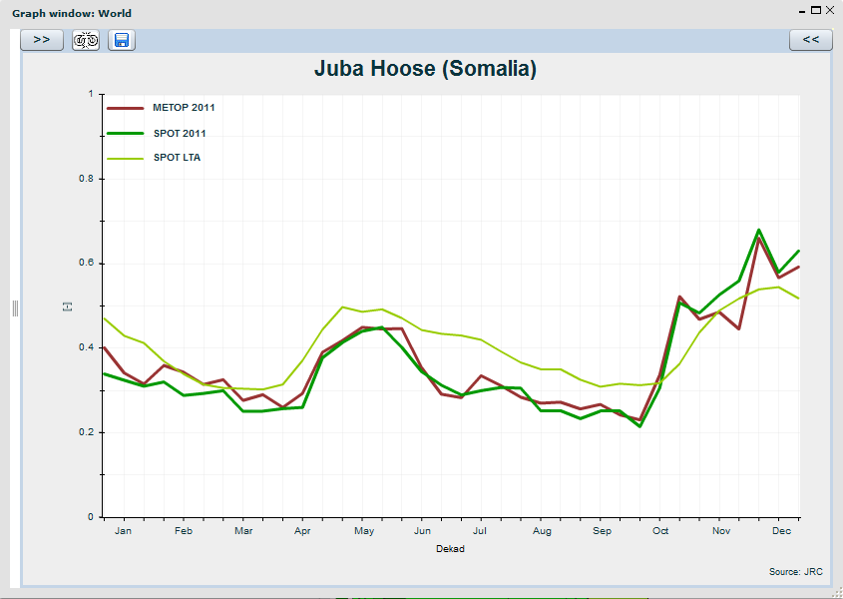
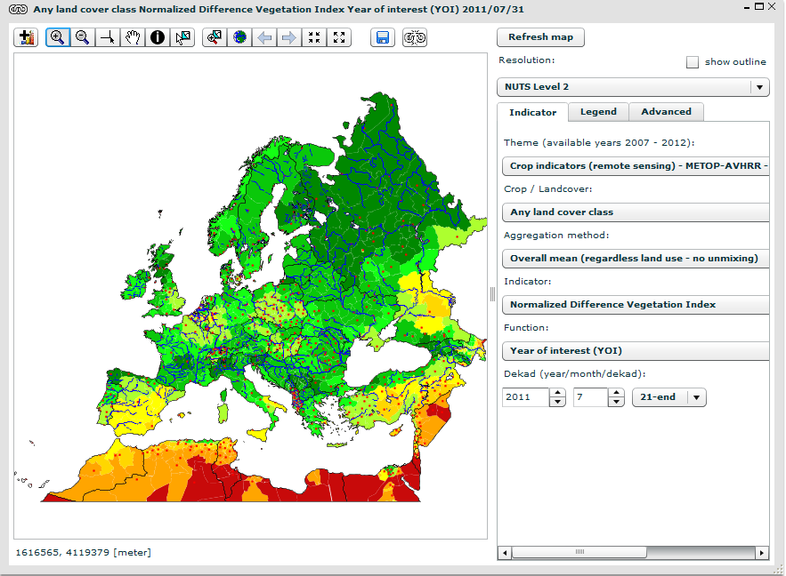
METOP-AVHRR (T5/T8): MARSOP DB & Viewer

Slide 20
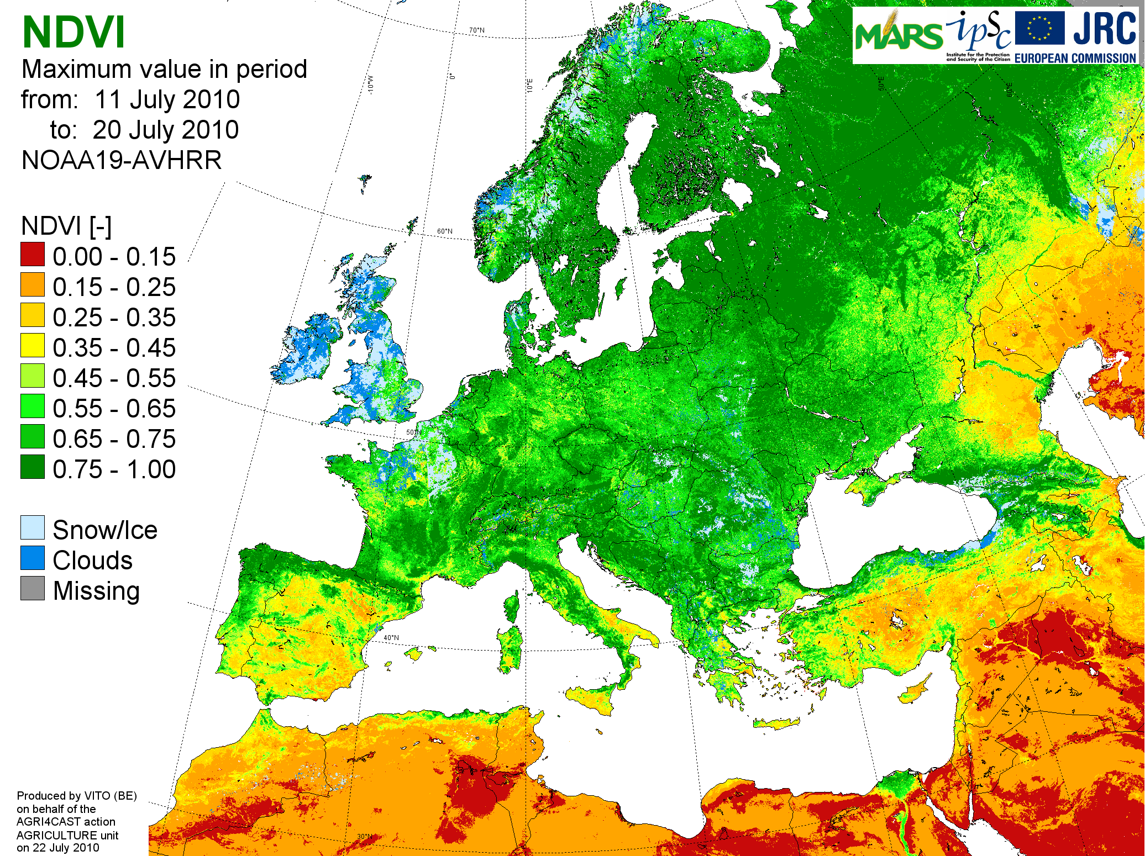
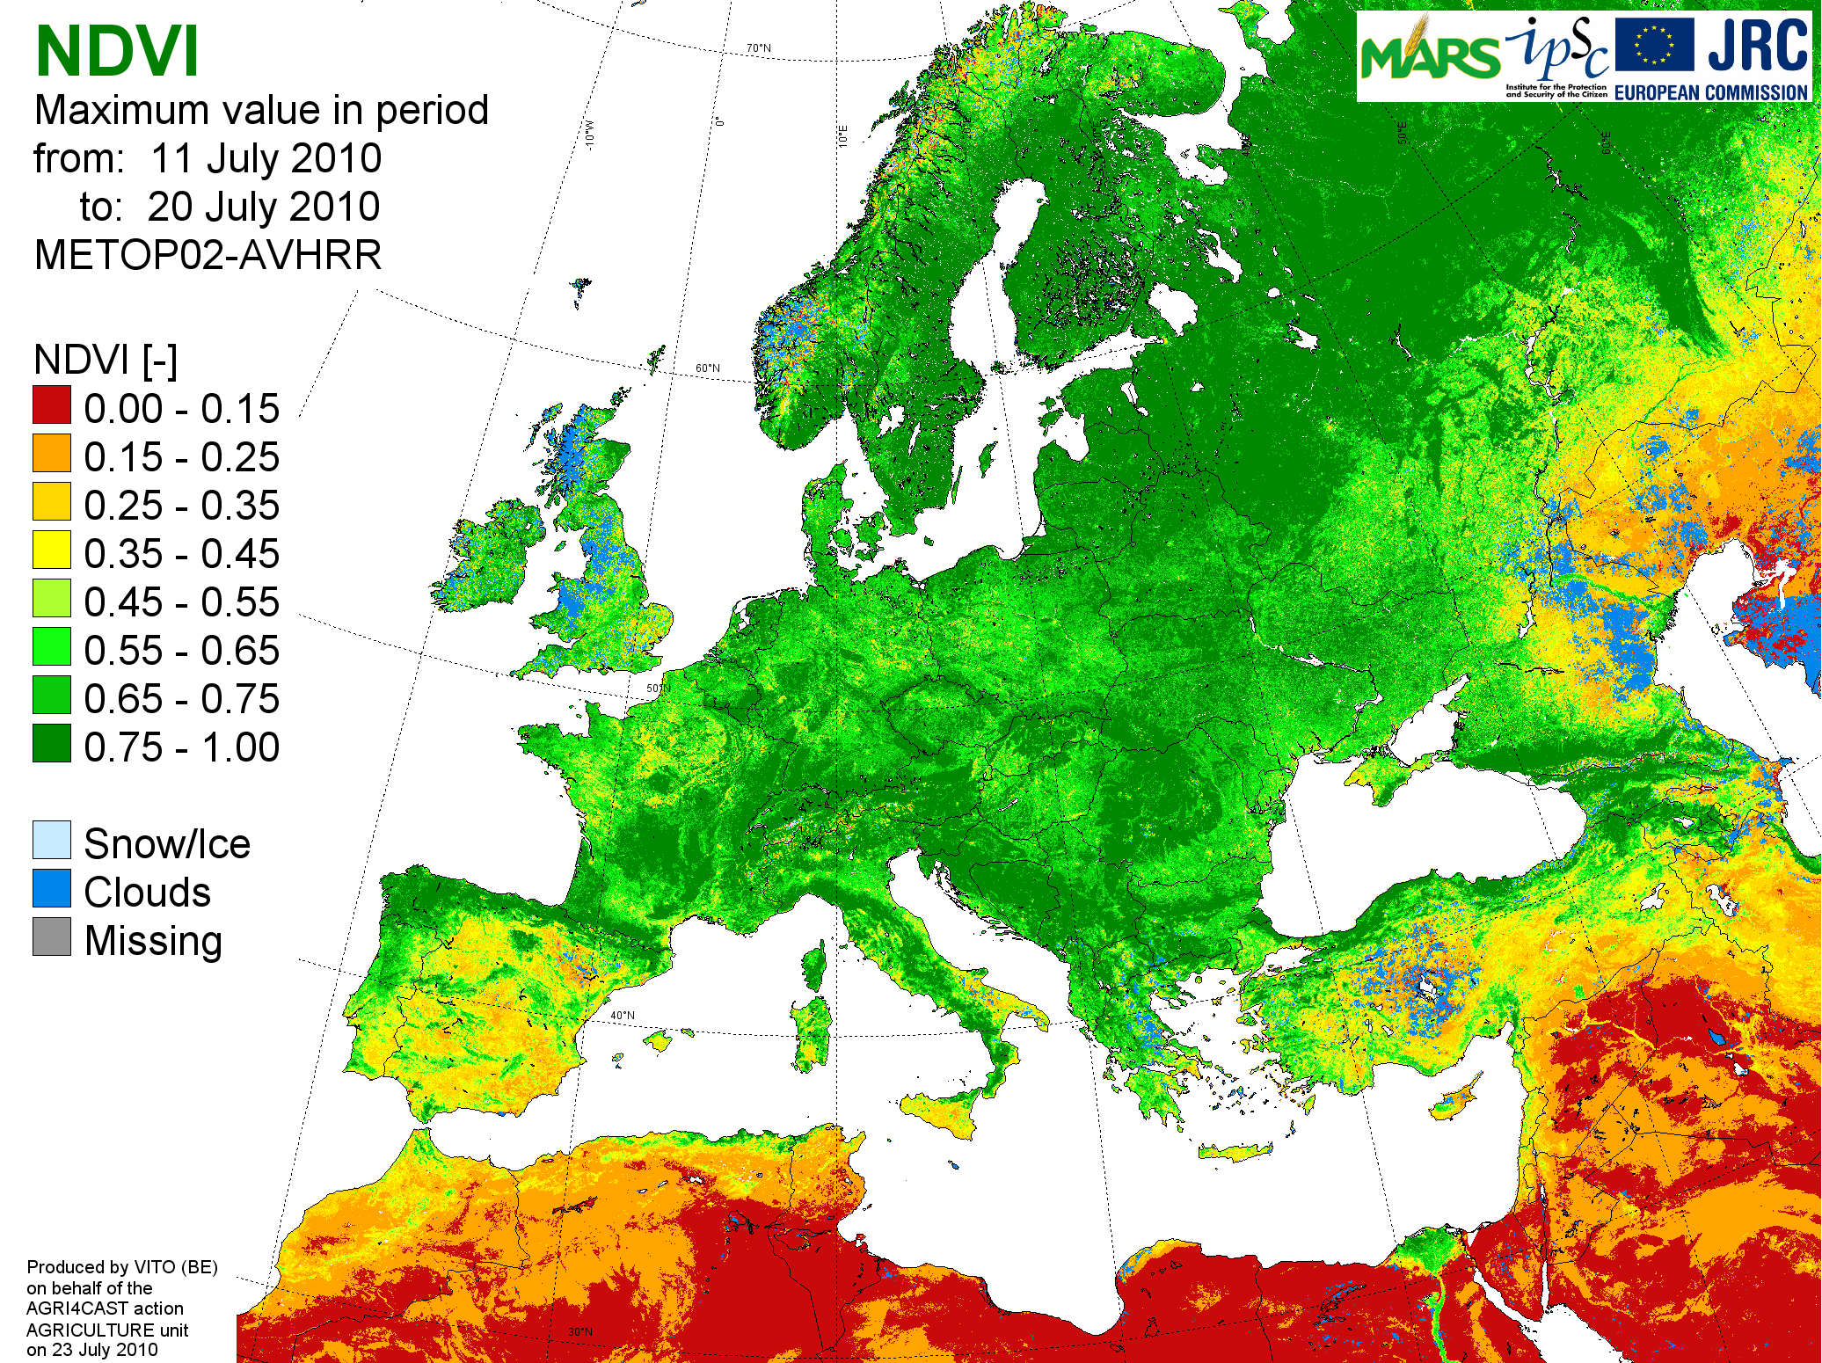
METOP-AVHRR (T5/T8): Comparison with NOAA-AVHRR NDVI
NDVI-S10 for Dekad 1 of September 2008
Remapped to INSPIRE-LAEA (1km)
NOAA-AVHRR (noon) METOP-AVHRR (morning)
MARSOP:
Archive of NOAA-AVHRR over Europe since 1981
METOP-AVHRR (since 2007) is systematically better

Slide 21
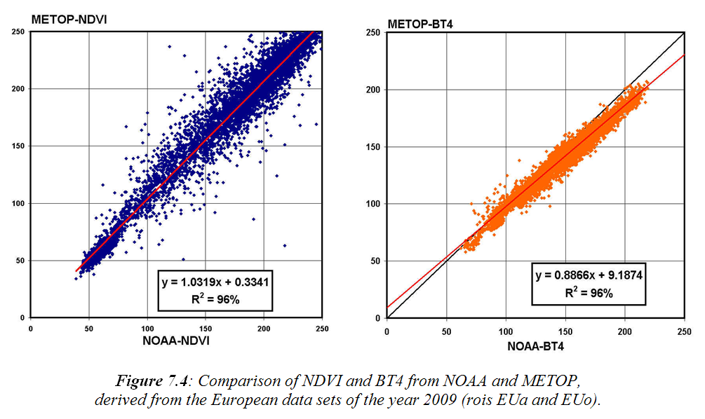
METOP-AVHRR (T5/T8): Comparison with NOAA-AVHRR NDVI

Slide 22
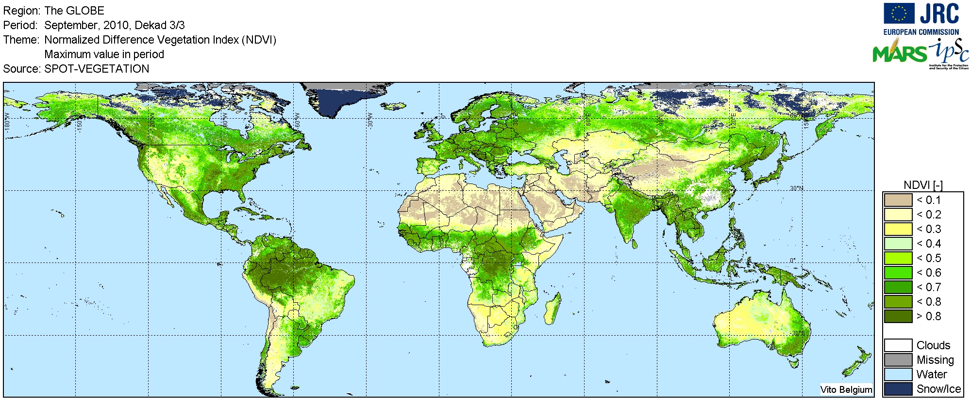
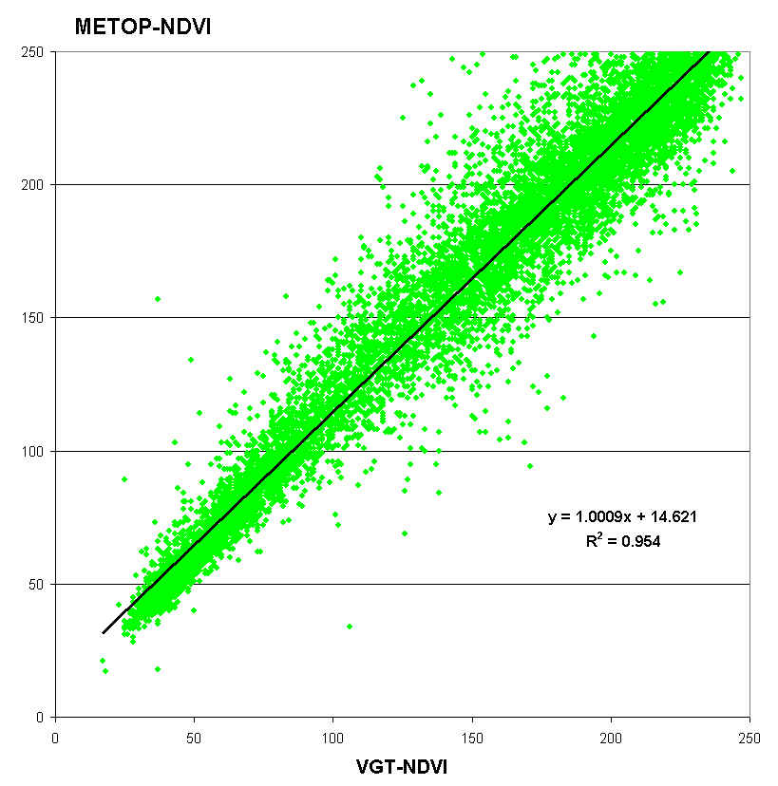
METOP-AVHRR (T5/T8): Comparison with SPOT-VGT (Aug.2011)
Method
Samples from paired S10-observations
From 12 global S10 of year 2009/2010
Both of same registration day!
Both absolutely cloudfree!
R² = 95%, Slope = 1.0
No improvement “per land cover class”
Residuals due to:
METOP 1h earlier than VGT
Different geometries
Different spectral response
Etc.
Conclusion: if SPOT-VGT fails, METOP is directly available alternative !

Slide 23
METOP-AVHRR (T5/T8): Launch of METOP-B
METOP-versions:
A/2 launched on 19 October 2006
B/1 launched on 17 September 2012
C/3 foreseen for 2016/2017
Mission continued until 2020 …
We contacted EUMETSAT (Jörg Ackerman, Dieter Klaes, …):
Switch between METOP-A and -B will be somewhere in 2013
Same formats, filenames, calibration approaches, etc.
Of course new spectral features (EUMETSAT provided all info)
VITO-tasks:
Define SMAC-coefficients with new SMAC-Toolbox
Adapt standard AVHRR chain (external specs files)

Slide 24
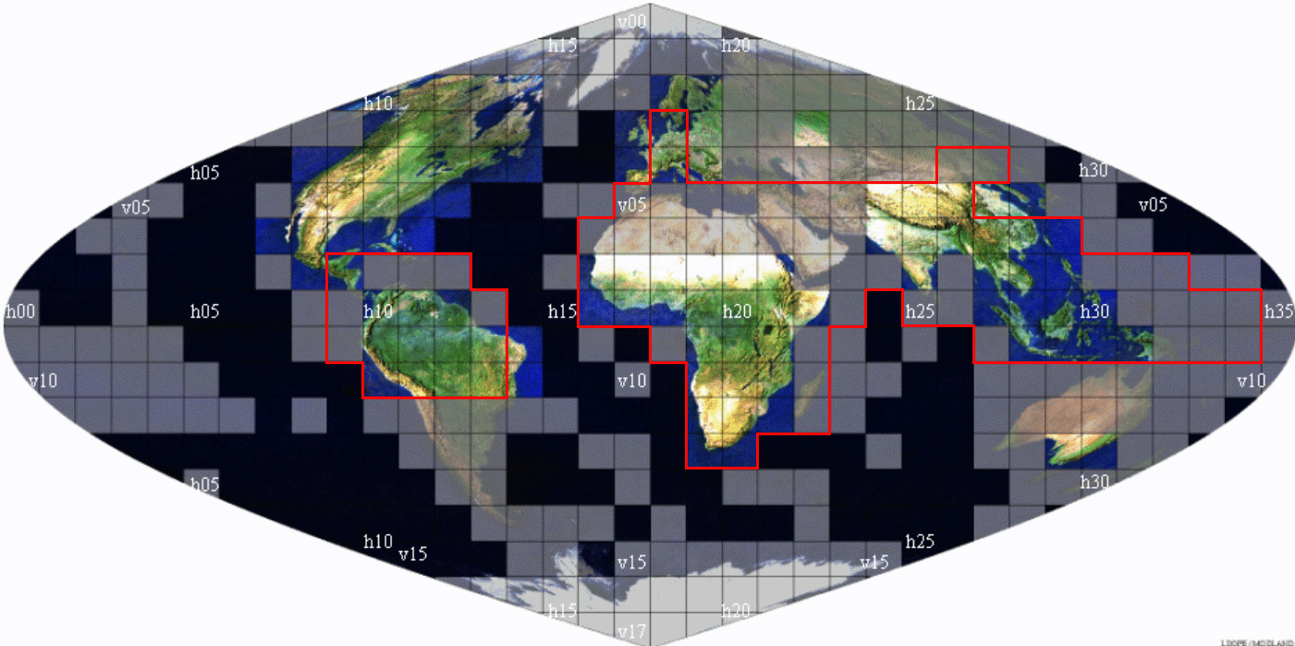
TERRA-MODIS (T6/T7): Pre-processing chain
LEVEL-1 data from LAADS (Maryland)
- Raw segments (“granules”)
. Calibrated to TOA-reflectances
. Lon/Lat-planes added
. Added masks of Land/Sea, Cloud/snow
At 250m for Red, NIR
500m for Blue, Red, NIR, SWIR, SWIR
LEVEL-2 data from LAND-DAAC
(Sioux-Falls, North Dakota)
Remap to Sinusoidal at ± 250m
Atmo-correction
Compositing
S1/S8/S16-composites at 250m
TOC-refl. in RED, NIR, plus NDVI
Global at ± 250m, sinusoidal
Subdivided in 10°-tiles
ASEMARS/MARSOP3 (since 2005)
VITO
Remap to 250m
Method of IES-Gobron:
. Atmo-correction using Blue!
. fAPAR-estimation
. Derive Blue-250m from 500m band
Max fAPAR + constraints on angles/status
JRC
S10-composites at 250m (max-fAPAR)
Europe / IGAD at 250m
fAPAR and TOC-refl. In Blue, RED, NIR
S10-composites at 250m

Slide 25
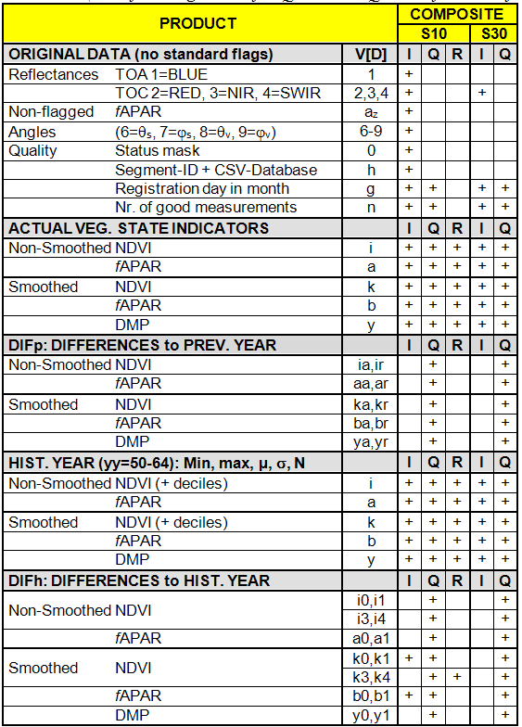
TERRA-MODIS (T6/T7): Post-processing - deliverables
Remarks
Identical to SPOT-VGTp over Europe
5 “crucial” variables:
- non-smoothed i-NDVI, a-fAPAR
- smoothed k-NDVI, b-fAPAR, y-DMP
Time series starts in March 2000
Historical Year based on series from April 2000 to March 2011 (11 years)
Not shown here:
- ISO-clustering
- Similarity analysis
DIFh-images only maintained for the ISO-clustering:
- IGAD: k0/b0 (abs.dif.)
- Europe: k1/b1 (rel.dif.)

Slide 26



TERRA-MODIS (T6/T7): Post – ISO-clustering
ISO-CLUSTERING
Scripts
Frequencies from histogram
Colours!
IGAD: Abs.Dif.

Slide 27






TERRA-MODIS (T6/T7): Post – Similarity analysis
SIMILARITY ANALYSIS
Scripts
Colours!
Separate QLKs per theme
IGAD:
- Third series starting in June
- Stop series after six months
- Only deliver QLKs not IMGs
To save time: derived from 5x5
thinned rois IGQt and EUQt

Slide 28
MARSOP3-LOT II (Remote Sensing)
Interim Meeting of Phase 3.2 (April 2012→October 2012)
5-6 November 2012, JRC-Ispra
Herman Eerens, Dominique Haesen, Bart Ooms,
Else Swinnen, Carolien Toté & Lieven Bydekerke
MANAGEMENT
TASKS MSG-SEVIRI Eur+Afr (T2)
SPOT-VGT Global (T8)
SPOT-VGTp Europe (T4)
NOAA-AVHRR Europe (T3)
METOP-AVHRR Global+Eur (T5)
TERRA-MODIS Eur+IGAD (T6/7)
C. SOFTWARE
D. CONCLUSIONS & PLANNING

Slide 29

POST-PROCESSING SOFTWARE: GLIMPSE & SPIRITS
Glimpse (DOS) Spirits (Windows)
Herman Eerens (25%) Dominique Haesen (100%)
Complex matter:
Technical elements
Contractual elements
Delays
IPR-issues
Different staff members
Interactions….
SPIRITS
GLIMPSE MANUAL
TUTORIAL

Slide 30
POST-PROCESSING SOFTWARE: SOME DATES
DATE | EVENT
2011-12-20 | VITO: Let’s postpone project until end of 2012 (instead of April 2012)
2012-02-08 | JRC: OK but penalty of 0.2% of 30k€ per day (1800 €/month)
2012-02-09 | IPR-meeting at VITO attended by JRC-Ispra, JRC-Brussels & VITO
2012-06-04 | JRC-Brussels sends draft proposal on IPR-issues
2012-07-20 | VITO: new SPIRITS version + MANUAL (candidate for 1st official release)
2012-09-04 | VITO: please provide feedback and official approvement
2012-09-07 | JRC: first reaction
2012-09-25 | JRC: list of corrections and suggestions for improvement
2012-09-26 | Informal meeting in Rome (Rembold, Eerens)
2012-09-27 | VITO: updated SPIRITS version accounting for part of JRC-comments
2012-10-02 | VITO: consider this as first official release & end of this amendment
2012-10-16 | JRC: OK (under certain conditions…)
2012-10-31 | VITO: Draft version of TUTORIAL
2012-11-06 | VITO: Draft version of new SPIRITS, now with FAO-modules, etc.

Slide 31
POST-PROCESSING SOFTWARE: GLIMPSE
New GLIMPSE modules (mainly for FAO-ASIS)
Continued Enhancements & Revisions
Corrections of bugs, reported by users/own experiences…
General revisions of library
New versions, e.g. CUMULATE, HDRadapt,…
PROGRAM | FUNCTIONALITY
INTERPOL | Modify the framing, resolution and/or extension of any input image.
SMOOTHwk | A modified version of the standard SMOOTH (cleaning of VI-series via a modified Swets algorithm), but acting on weekly inputs (e.g. NOAA-AVHRR from STAR).
VHI | Computation of the Vegetation Health Index, as VHI=w.VCI+(1-w).TCI, with VCI=Vegetation Condition Index, TCI=Temperature Condition Index, and w the relative weight [0.0 – 1.0] assigned to the VCI. Optionally, the weights can be read from an image, thereby allowing for local variations.
PHENOdat | Time series analysis which detects per year and per pixel the start and end of the single or double season(s): SOS1, EOS1, SOS2, EOS2.
PHENOnow | Computes an image which indicates for each pixel the progress of the current season, via the index P_{sos}= [Today - SOS] / [EOS - SOS]. Actually, two such images are retrieved, one for each season.
PHENOcum | This program calculates per pixel the sum/mean of a dekadal time series between SOS and EOS (or “today”, if EOS is not yet reached) as defined by PHENOdat.
CLS2RUM | Modified version of the standard IMG2RUM, but focussing on frequencies. Spatial aggregation, i.e. extraction of RUM-databases with per administrative region the percentage of pixels of a certain class and having image values in a certain range. For instance, the frequency of cropland pixels in a certain region with VHI below 35%.
RUM2IMG | The opposite of IMG2RUM or CLS2RUM: Reconversion of a RUM-file to image format.

Slide 32
POST-PROCESSING SOFTWARE: SPIRITS-versions
Always and by default: bug fixes, UI-improvements, etc.
20 July 2012: Draft version of V1.0 (see Annex 3):
New GLIMPSE modules added: IMG2STK, FREQ, ISOclustering
HELP-functionality implemented in software (via PDF-library)
HELP-manual written (252 pages) with main functionalities of SPIRITS
27 September 2012: First official release version V1.0 (see Annex 4)
Correction of part of the suggestions made by JRC on 25/9.
6 November 2012: Draft of version V1.1
Correction of another part of the suggestions made by JRC on 25/9.
Inclusion of more GLIMPSE modules developed for FAO-ASIS
Adaptation of SPIRITS manual
Technical inclusion of the new tutorial

Slide 33
MARSOP3-LOT II (Remote Sensing)
Interim Meeting of Phase 3.2 (April 2012→October 2012)
5-6 November 2012, JRC-Ispra
Herman Eerens, Dominique Haesen, Bart Ooms,
Else Swinnen, Carolien Toté & Lieven Bydekerke
MANAGEMENT
TASKS MSG-SEVIRI Eur+Afr (T2)
SPOT-VGT Global (T8)
SPOT-VGTp Europe (T4)
NOAA-AVHRR Europe (T3)
METOP-AVHRR Global+Eur (T5)
TERRA-MODIS Eur+IGAD (T6/7)
C. SOFTWARE
D. CONCLUSIONS & PLANNING

Slide 34
CONCLUSIONS What’s been done this semester?
A. STANDARD MARSOP OPERATIONS
NRT-processing & reporting
Problem solving: Sudan-boundaries, new logos, …
Deliveries to third parties
B. SOFTWARE
Technical improvements in GLIMPSE & SPIRITS
First official release on 25 September 2012
Further discussions on IPR, further planning, etc.
C. DOCUMENTATION
SPIRITS-Manual → Dominique Haesen
SPIRITS-Tutorial → Carolien Toté
WIKI, partim Remote Sensing → Else Swinnen

Slide 35
CONCLUSIONS Planning for next semester (until April 2013)
A. STANDARD MARSOP OPERATIONS
NRT-processing, data deliveries & reporting
Solution of unforeseen events
Finalize the WIKI
B. SENSOR-SPECIFIC TASKS
Update Historical Year (LTA) of SPOT-VGT/VGTp, NOAA-AVHRR
Correct for gaps in MSG-data from LSA SAF
Replacement of METOP-A/2 by METOP-B/1 (spring 2013).
C. SOFTWARE & RELATED
Continued improvements of GLIMPSE & SPIRITS
See dedicated discussion on GLIMPSE/SPIRITS of tomorrow (7/11/2012)
Subjects: IPR, ABOUT-box, menu structure, planning, etc.

Slide 36

CONCLUSIONS Planning for next semester (until April 2013)
Still pending: 1.Final contents of the “About” box.
2.Distribution channel for SPIRITS
How?
By whom: JRC or VITO?
Contents?

Slide 37
MARSOP3-LOT II (Remote Sensing)
Interim Meeting of Phase 3.2 (April 2012→October 2012)
5-6 November 2012, JRC-Ispra
Herman Eerens, Dominique Haesen, Bart Ooms,
Else Swinnen, Carolien Toté & Lieven Bydekerke
MANAGEMENT
TASKS MSG-SEVIRI Eur+Afr (T2)
SPOT-VGT Global (T8)
SPOT-VGTp Europe (T4)
NOAA-AVHRR Europe (T3)
METOP-AVHRR Global+Eur (T5)
TERRA-MODIS Eur+IGAD (T6/7)
C. SOFTWARE
D. CONCLUSIONS & PLANNING
Thank You

